Slide 1

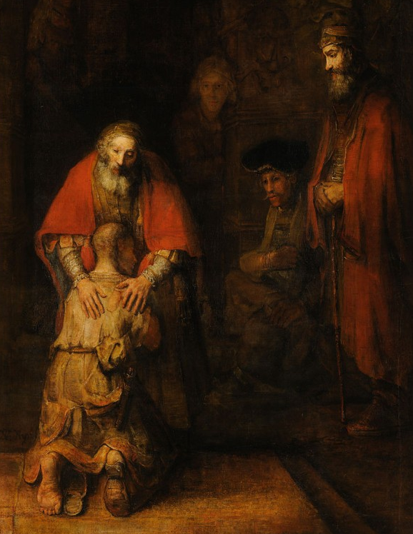
The Return of the Prodigal Son by Rembrandt Van Rijn, c. 1668
The parable of the Prodigal Son is the third of three parables in Luke 15, with the theme that Heaven rejoices for even one sinner who repents. Notwithstanding popular focus on its title character, the parable is in fact a nuanced and incisive story about relationships, redemption, justice and God’s boundless love. These themes are the basis of Gatekeepers’ Re-entry program.

Slide 2
A UNIQUE COMMUNITY PARTNERSHIP
        First Minutes of Freedom
        Maslow
        Business of Living
        Next Steps Guide
        Resource Club
        Housing Project
        Citizens Meeting Returning Citizens

Slide 3
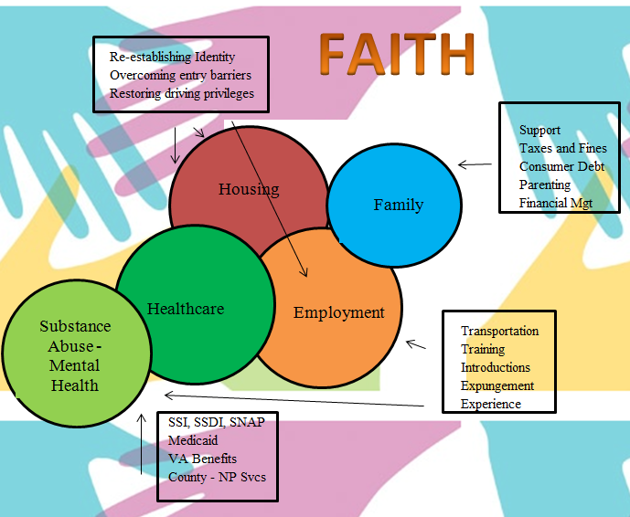
GATEKEEPERS HELPS BRIDGE THE GAP

Slide 4
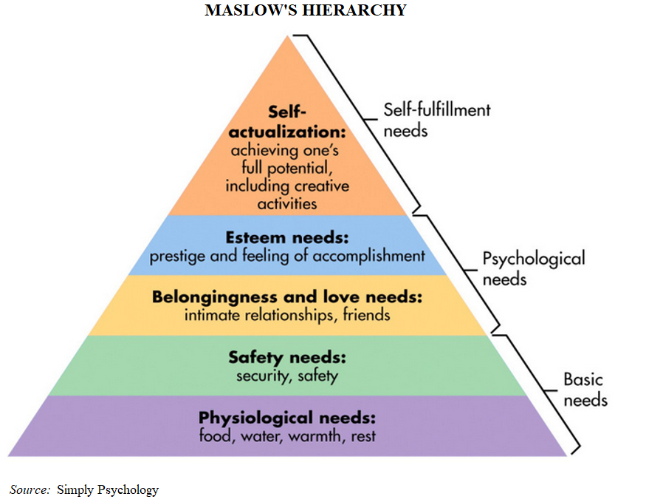
GATEKEEPERS RESPONDS TO BASIC NEEDS

Slide 5
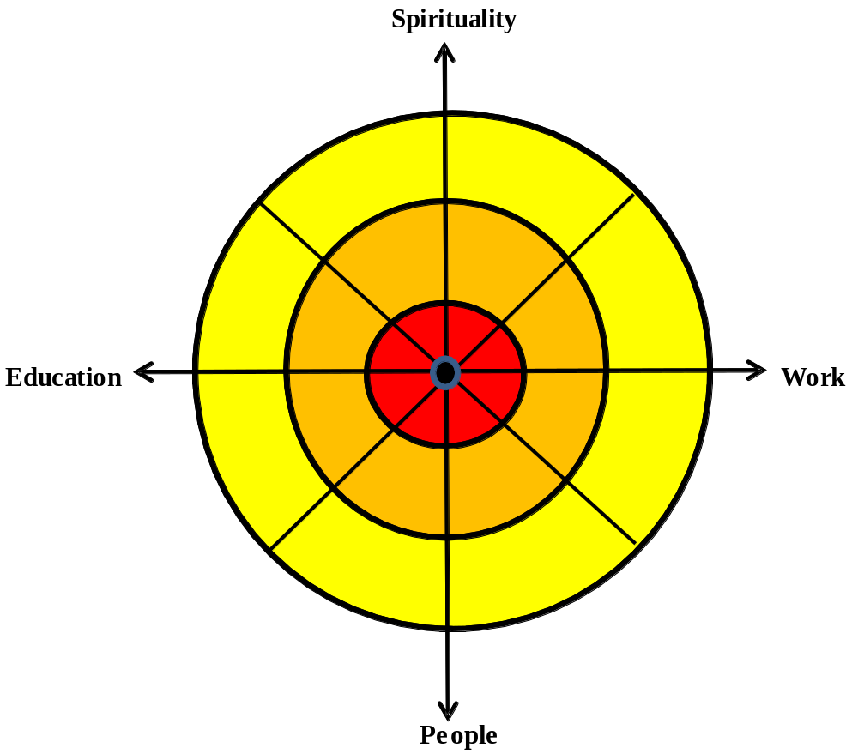
GATEKEEPERS COACHES IN THE BUSINESS OF LIVING
Each individual has the opportunity to jump-start his or her own life business. Every day we examine our lives: education, occupation and interpersonal relationships. We know we have to get smarter, better at our jobs, and be better people. Gatekeepers strives to empower individuals to overcome impediments to be who whey want to be.
The Business of Living program includes lessons in civics, speaking skills and anger management in addition to the “Resource Club” a weekly group that functions as an experience exchange. In furtherance of Gatekeepers efforts to promote employment, staff works with local businesses, parole and probation, and social service agencies.

Slide 6
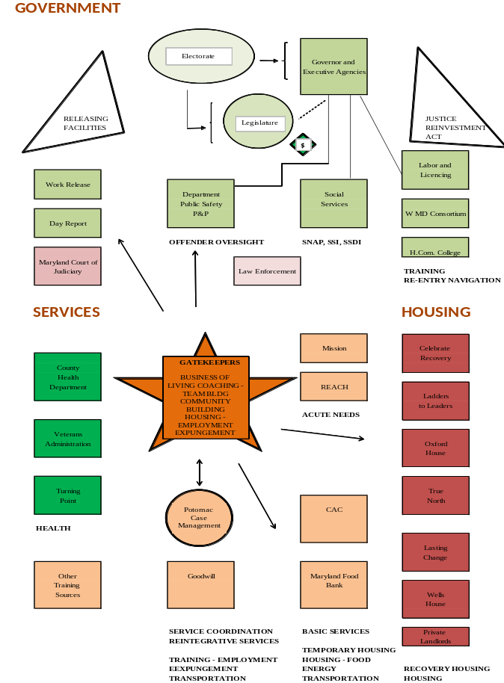
GATEKEEPERS CONNECTS PEOPLE AND RESOURCES

Slide 7
GATEKEEPERS ALUMNI
Steve A, executive chef, Baltimore
Keith R, operations director property preservation company, Baltimore
Bill G, re-entry program director, Hagerstown
Robert M, peer mentor, Hagerstown
Bill W, peer mentor, Hagerstown
Roger S, construction supervisor, North Carolina
Joe F, warehouse supervisor, PA
Darren H, recovery program participant, Hagerstown
Greg R, project manager, NV
Brad J, insurance sales, Hagerstown
11. David B, recovery program participant, Hagerstown
12. Phil C, construction supervisor, Baltimore
13. George J, Macy’s employee, Hagerstown
14. Luke J, re-offended, HagerstowN
15. Tim K, retired, Hagerstown
16. Mike H, reoffended, Hagerstown
17. Bill D, construction worker, Baltimore
18. Ralph J, masonry worker, Hagerstown
19. Darius H, self-employed, Hagerstown
20. Chris D, plumbing, Hagerstown

Slide 8
GATEKEEPERS ALUMNI
21. Katherine M, housecleaner, Hagerstown
22. Luiz P, convenience store worker, Hagerstown
23. Dustin S, warehouse worker, Hagerstown
24. Steve R, bakery supervisor, Hagerstown
25. Jennifer H, college student, Hagerstown
26. Gerald H, transportation company owner, Hagerstown
27. Brian F, plumber, Baltimore
28. Al T, FedEx driver, Hagerstown
29. Darrell S, convenience store manager, Hagerstown
30. Ollie L, FedEx manager, Hagerstown
31. Robert R, taxi driver, Hagerstown
32. Chris R, warehouse worker, Hagerstown
33. Michael C, college student, Hagerstown
34. Tony T, fire protection specialist, Hagerstown
35. Scott H, food service worker, Hagerstown
36. .Lyn F, short order cook, Hagerstown
37. Jim F, Macy’s employee, Hagerstown
38. Karen C, food service worker, Hagerstown
39. Al W, recovery program participant, Hagerstown

