Slide 1

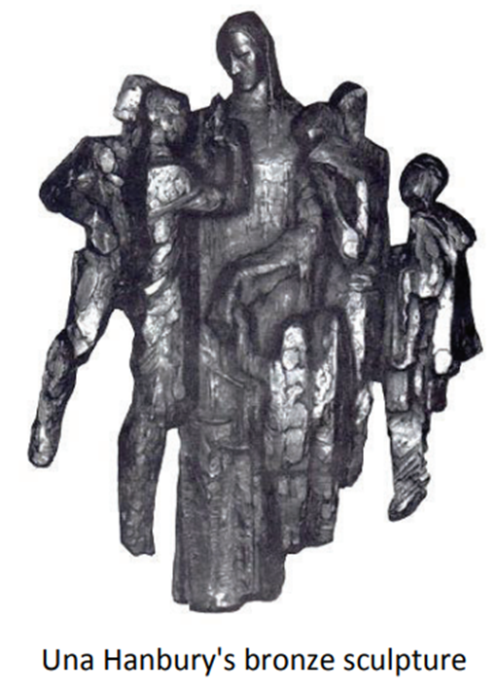
Maryland Office of the Chief Medical Examiner (OCME) Overview
Stephanie A. Dean, M.D.
Chief Medical Examiner
“Wherever the art of medicine is practiced there is also a love of humanity.”
Notes:
Thank you for the opportunity to speak to all of you today.
As the State’s OCME, our role in deaths occurring in custody is both highly specialized and extremely important. We aim to approach these cases with a forensic, independent, and evidence-driven lens in an effort to focus on determining what and how things happened.
Over the past few years, we have worked to strengthen our internal processes, improved transparency, and adapted to evolving expectations of public accountability.
Today, I will give an overview of our agency:
Background on the OCME and death investigation system of the United States
our approach to documentation and investigation
Discuss principles that guide our cause and manner of death determinations
OCME mission, case criteria, and workflow timeline
Custodial death data overview
Future directions and initiatives
Goal is to provide some clarity on our processes, what we can speak to, and where our findings fit within the broader context of oversight, justice, and public health

Slide 2
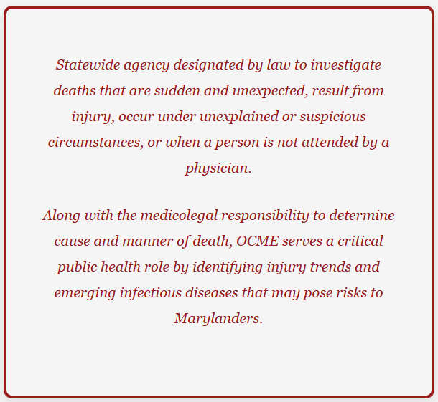
Overview
Notes:
The OCME serves the State of Maryland as an independent, science-based agency responsible for objective medicolegal death investigation. Our mission is to uphold public trust through impartial, accurate, and timely determinations; to protect the dignity of every decedent; to support families; and to contribute to public health, safety, and justice through transparent collaboration with government and community partners.

Slide 3
History of the Maryland OCME
1939: Established first statewide ME system in US
  Postmortem Examiners Commission (PMEC) formed
  In 2023 MDH became responsible for staffing and OCME funding
Defined in statute as independent agency
  Health General Title 5
  HG5-309(d)(iv): The Department and the Committee may not interfere with the clinical findings or conclusions prepared under subparagraphs (i) and (ii) of this paragraph.
Postmortem Examiner’s Committee:
  The legislative changes in 2023 effectively removed the Commission’s statutory authority, including its ability to approve appointments and policy changes, placing those powers with the Chief Medical Examiner and the Secretary of Health.
Notes:
The unpaid commission would be nonpartisan and nonpolitical, have expertise to appoint and supervise qualified medical examiners, and provide a link to university and state laboratories for assistance when needed.
2023: became advisory allowing us to better execute management decisions
Maldeis: 1939-1949: “One of the most important duties of the chief medical examiner is to protect those concerned after the demise of a loved one, and to see that they are dealt with honestly.”
Fisher: 1949-1984
Smialek: 1986-2001
Fowler: 2002-2019
Weedn: 2021-2022
Dean: 2023-present

Slide 4
History of Maryland’s Chief Medical Examiners
Dr. Howard J. Maldeis (1939 – 1949)
Dr. Russell S. Fisher (1949 – 1983)
Dr. John E. Smialek (1983 – 2001)
Dr. David R. Fowler (2003 – 2019)
Interim/Acting CME (Jan 1, 2020- Feb 2021)
Dr. Victor Weedn (2021 – 2022)
Interim/Acting CMEs (Feb 2022 - Nov 2023)
Dr. Stephanie A. Dean (2023 – Present)
“One of the most important duties of the chief medical examiner is to protect those concerned after the demise of a loved one, and to see that they are dealt with honestly.”
-Dr. Maldeis
Notes:
The unpaid commission would be nonpartisan and nonpolitical, have expertise to appoint and supervise qualified medical examiners, and provide a link to university and state laboratories for assistance when needed.
2023: became advisory allowing us to better execute management decisions
Maldeis: 1939-1949: “One of the most important duties of the chief medical examiner is to protect those concerned after the demise of a loved one, and to see that they are dealt with honestly.”
Fisher: 1949-1984
Smialek: 1986-2001
Fowler: 2002-2019
Weedn: 2021-2022
Dean: 2023-present

Slide 5
Maryland OCME Mission and Responsibilities
  Provide independent, expert, and compassionate medicolegal death investigation for the State of Maryland
  Identify and monitor public health risks and emerging threats
  Contribute to national defense and preparedness for mass casualty events
  Honor every decedent with dignity and respect
  Serve grieving families with clarity and compassion
  Advance forensic and medical science by training the next generation of forensic professionals
  Continually contribute to strengthening the systems that support justice, public health, and community well-being
Notes:
The unpaid commission would be nonpartisan and nonpolitical, have expertise to appoint and supervise qualified medical examiners, and provide a link to university and state laboratories for assistance when needed.
2023: became advisory allowing us to better execute management decisions
Statewide agency designated by law to investigate deaths that are:
sudden and unexpected
result from injury
occur under unexplained or suspicious circumstances, and/or
when a person is not attended by a physician
Along with the medicolegal responsibility to determine cause and manner of death, OCME serves a critical public health role by identifying injury trends and emerging infectious diseases that may pose a threat to Maryland citizens

Slide 6



Accreditation(s)
OCME: Accredited by the National Association of Medical Examiners (NAME)
OCME Toxicology Lab: Accredited by the College of American Pathologists (CAP)
Forensic Pathology Fellowship Program: Accredited by the Accreditation Council for Graduate Medical Education (ACGME)

Slide 7
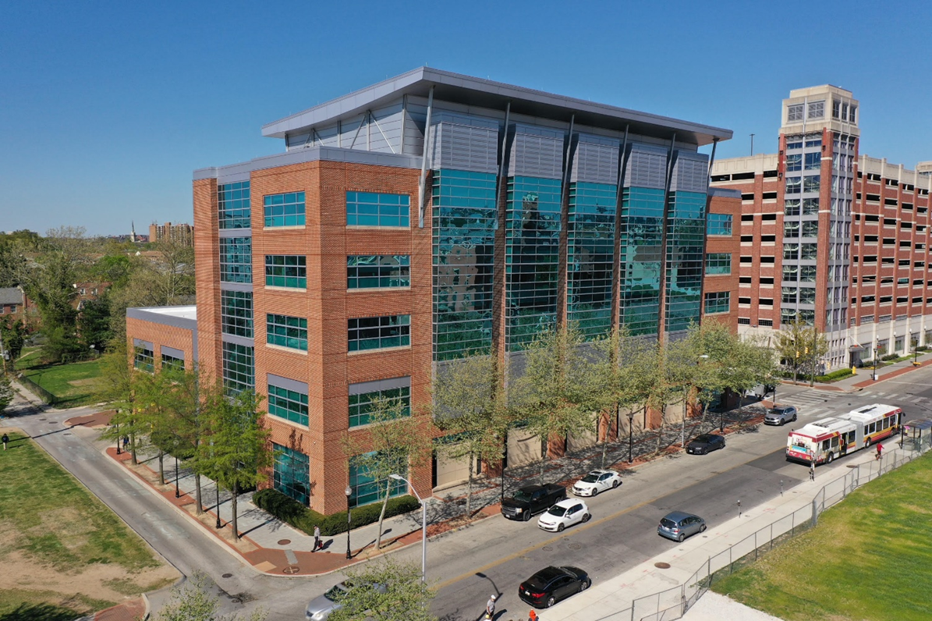
Maryland Forensic Medical Center
Occupied in 2010
120,000 SF, 6 floors
22 autopsy stations
Digital radiology
BSL3/Isolation area
Receiving garage
MF triage area
Conference/teaching
Museum/Nutshells

Slide 8
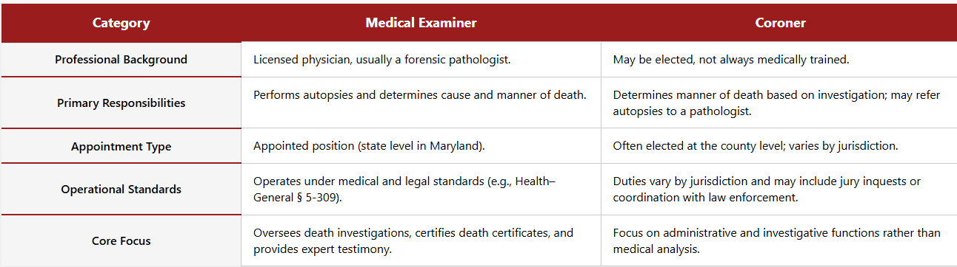
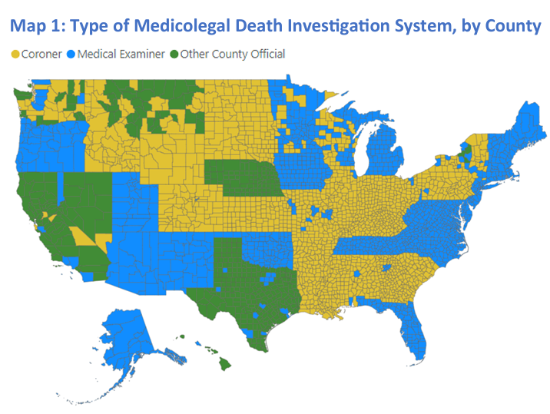
Medical Examiner vs. Coroner
Notes:
ME In all counties:
• Centralized state medical examiners (11 states and DC): AK, CT, DC, DE, MA, MD, ME, NH, NM, RI, UT, VT
• Regional medical examiners (3 states): FL, OK, VA
• County-based medical examiners (8 states): AZ, IA, MI, NC, NJ, OR, TN, WV

Slide 9
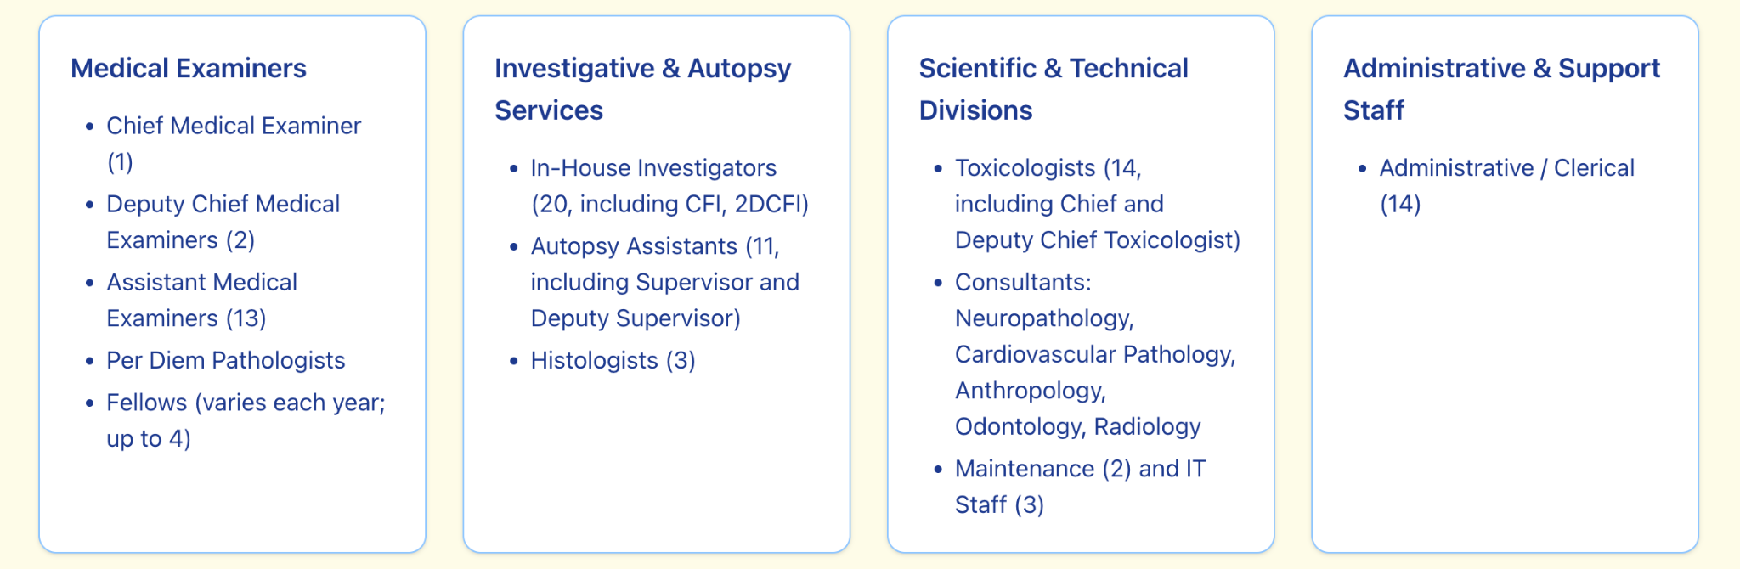
OCME Team
Notes:
5.7 Contractual PINS
12 vacancies
Roughly 100 staff, all within centralized location in Baltimore City

Slide 10
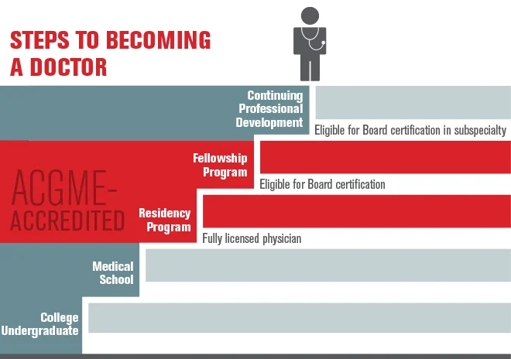
Medical Examiners
Forensic Pathologist
  College degree (4 years)
  Medical school (4 years)
  Pathology residency (3-4 years)
  Fellowship in forensic pathology (1 year)
    30-40 complete per year
  Board certification in forensic pathology
    Only 300-400 practicing in U.S.
Appointed
Non-Political Position
State, District or County Jurisdiction

Slide 11
Death Investigation Coordination
City Forensic Investigators (FIs)
Full-time OCME staff based in Baltimore
Essential 24/7/365 coverage
Respond to city scenes and assist counties as needed
County Forensic Investigators
Contracted vendors working on behalf of OCME
Call in all reported deaths for jurisdictional verification and case number assignment
On-call, covering multiple counties per shift
Decedent Transport Services
Once jurisdiction is accepted, contracted transport providers deliver the decedent to OCME
Operate under OCME supervision with strict chain-of-custody and handling protocols

Slide 12
Medicolegal Definitions
Police-involved: deaths temporally occurring in the presence of law enforcement (pre-custody)
  To include: police encounters (prior to the physical restraint associated with arrest), officer-involved shootings, and police pursuits
In-custody:
  Death of any person who is detained, under arrest, or is in the process of being arrested, is en route to be incarcerated, or is incarcerated at any local or State police, detention, or correctional facility (including any juvenile facility).
  In-custody death during law enforcement restraint:
    Death is associated with law enforcement coming into contact with the decedent and actively restraining the decedent by bodily force, mechanical restraints, blunt impact, chemical means, conducted energy devices, non-lethal weapons, or lethal weapons.
Notes:
Definition: “in-custody death” is the death of any person who is detained, under
arrest, or is in the process of being arrested, is en route to be incarcerated, or is
incarcerated at any local or State police, detention, or correctional facility (including
any juvenile facility).
An “in-custody death during law enforcement restraint” refers to
a case being investigated by OCME where the death is associated with law
enforcement coming into contact with the decedent and actively restraining the
decedent by bodily force, mechanical restraints, blunt impact, chemical means,
conducted energy devices, non-lethal weapons, or lethal weapons.

Slide 13
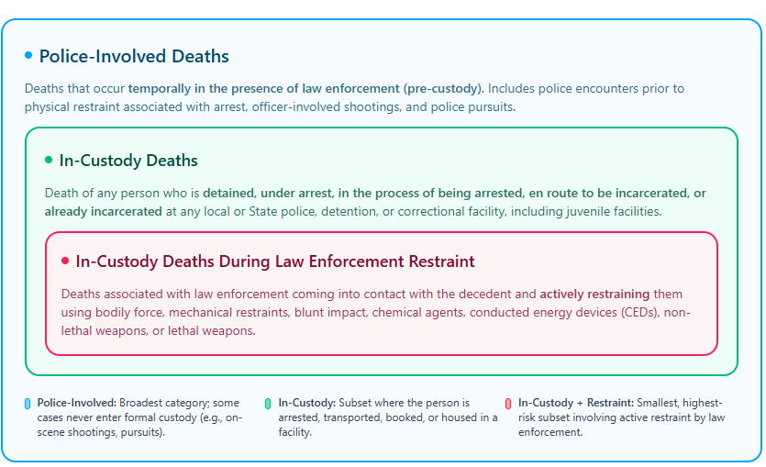
Notes:
Definition: “in-custody death” is the death of any person who is detained, under
arrest, or is in the process of being arrested, is en route to be incarcerated, or is
incarcerated at any local or State police, detention, or correctional facility (including
any juvenile facility).
An “in-custody death during law enforcement restraint” refers to
a case being investigated by OCME where the death is associated with law
enforcement coming into contact with the decedent and actively restraining the
decedent by bodily force, mechanical restraints, blunt impact, chemical means,
conducted energy devices, non-lethal weapons, or lethal weapons.

Slide 14
Medicolegal Death Investigation: a Step-by-Step Walkthrough

Slide 15
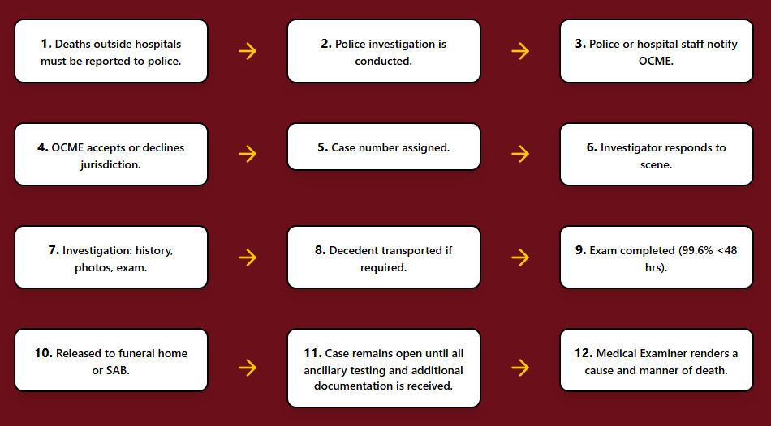
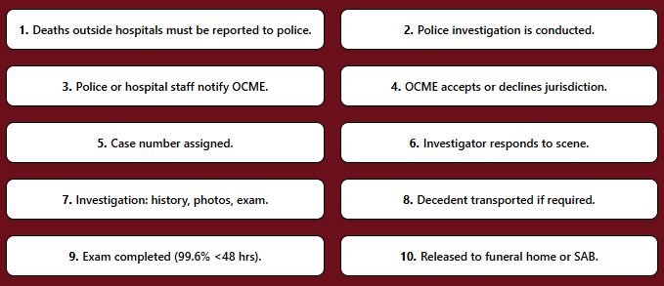
Overall OCME Case Process Flow

Slide 16
Step 1/2: Interagency Collaboration
Who reports cases?
  Any physician, funeral director or any other person who believes that a death is suspicious is required to report it to the local law enforcement agency where the death occurred. – COMAR 10.35.01.02
Role of Law Enforcement
  Secure and control the death scene
  Report case to OCME with all required information
  Confirm identity of the decedent
  Notify next-of-kin
  Conduct independent investigation

Slide 17
Step 3: OCME Notification Process
Call is placed by hospital staff or law enforcement to the 24-hour OCME Forensic Investigations on-call staff.
If additional concerns or questions arise during the notification process, the call is routed to the on-call Forensic Pathologist (ME) for consultation.
  All calls are documented and reviewed by the on-call Medical Examiner the following day as part of quality assurance oversight.

Slide 18
Step 4/5: OCME Accepts or Declines Jurisdiction
All reported deaths are assigned a case number upon initial notification.
If OCME accepts jurisdiction, the agency assumes responsibility for the decedent, and the forensic investigator initiates steps 6-10.
If OCME jurisdiction is not established, responsibility remains with the reporting institution, which coordinates final arrangements with the funeral home and the decedent’s designated person in interest.
*Note: Not ALL deaths in Maryland are reported to the OCME

Slide 19
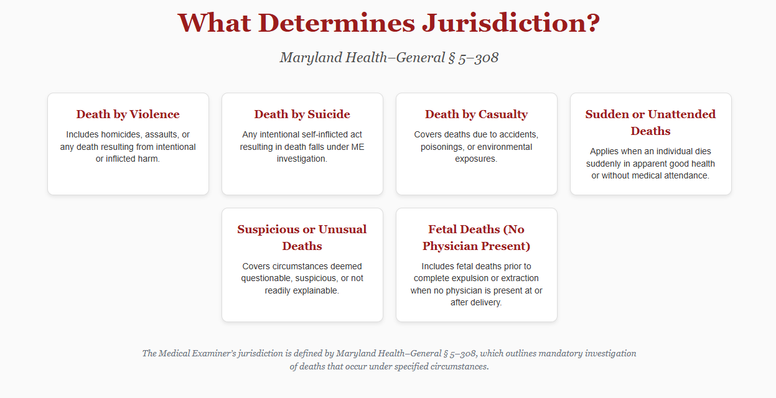
Step 4: Case Acceptance Expanded
COMAR Reference: 10.35.01.02
Notes:
Important distinction: statute defines what OCME is responsible for INVESTIGATING, it does not mandate that all of these cases require acceptance of jurisdiction and/or transport to our facility for a postmortem examination.
“Any death that is not solely and exclusively due to natural causes.”
Any death where any reasonable suspicion is raised by any person of interest.
• Maryland population is 6.2 million
• About 50-58,000 total statewide deaths annually
• About 16-17,000 deaths referred/reported to OCME
• About 10,000 cases accepted
• About 6,000 postmortem examinations performed annually
• Average of 16-20 autopsies a day

Slide 20
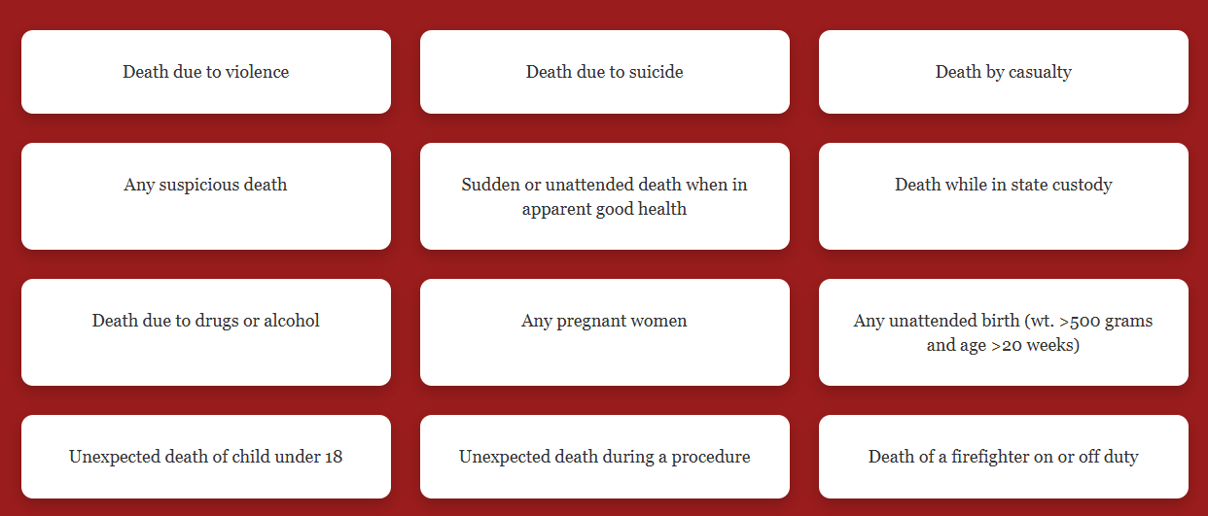
Step 4: Case Acceptance Expanded
“Any death that is not solely and exclusively due to natural causes.”
Any death where any reasonable suspicion is raised by any person of interest.
COMAR Reference: 10.35.01.02

Slide 21
Steps 4/5: OCME Case Classifications
Accept Jurisdiction
  Scene Inspection
  Approval
  OCME Examination
    Full or partial autopsy
    OCME Inspection: external examination
    CT Autopsy
Declined Jurisdiction: Did not meet Health-Gen 5-308 criteria for acceptance, but OCME is aware of the decedents’ passing.
Case was not reported to the OCME
  Example: Death secondary to natural causes under the care of a physician at a medical institution.

Slide 22
Steps 6-8: OCME Investigative Process
Once a case is accepted, OCME conducts its own investigation independent of law enforcement, hospitals, or other reporting agencies.
Forensic investigators gather scene information, photographs, and medical history directly to establish the circumstances leading to death.
OCME verifies and cross-references information from police, EMS, and medical records to ensure findings are based on objective evidence.
The medical examiner evaluates all investigative data in conjunction with autopsy and toxicology results to determine the cause and manner of death.

Slide 23
Step 9: The Forensic Autopsy
A physical examination of a person after death
Full autopsy takes 2.5-3 hours (average); dependent on complexity
External exam of body and clothing
  Documented by photographs, measurements, diagrams
  Identifying features, medical therapy, injuries
Internal exam
  Examining all organs/tissues to identify disease and/or injury processes that caused/contributed to death
  Weights, measurements, diagrams, photos
Ancillary testing: toxicology, histology, radiology, microbiology
Review of pertinent medical records
Complete and sign the death certificate

Slide 24
Step 9: The Forensic “In-Custody” Autopsy
Restraint-related protocol is initiated for the autopsy team (established in June 2025), when applicable; in custody photography protocol initiated
All deaths during law enforcement restraint are required to be presented during OCME consensus conference
OCME leadership (CME or DCME) reviews and signs all law enforcement restraint-related autopsy reports.
All sources of investigative information must be documented in the investigation report
Non-OCME personnel present at autopsies are identified and directed to the observation deck during the procedure.
NAME scientific position papers, including extended guidance on in-custody deaths, are recognized in determining cause and manner of death.
Notes:
Definition: “in-custody death” is the death of any person who is detained, under
arrest, or is in the process of being arrested, is en route to be incarcerated, or is
incarcerated at any local or State police, detention, or correctional facility (including
any juvenile facility).
An “in-custody death during law enforcement restraint” refers to
a case being investigated by OCME where the death is associated with law
enforcement coming into contact with the decedent and actively restraining the
decedent by bodily force, mechanical restraints, blunt impact, chemical means,
conducted energy devices, non-lethal weapons, or lethal weapons.

Slide 25
Step 10: Release of Jurisdiction
Upon completion of the examination, OCME releases jurisdiction of the decedent.
Decedents are released to a funeral home in coordination with the designated person in interest.
If the decedent remains unclaimed after all reasonable efforts to locate next of kin, jurisdiction is transferred to the State Anatomy Board (SAB) for final disposition.

Slide 26
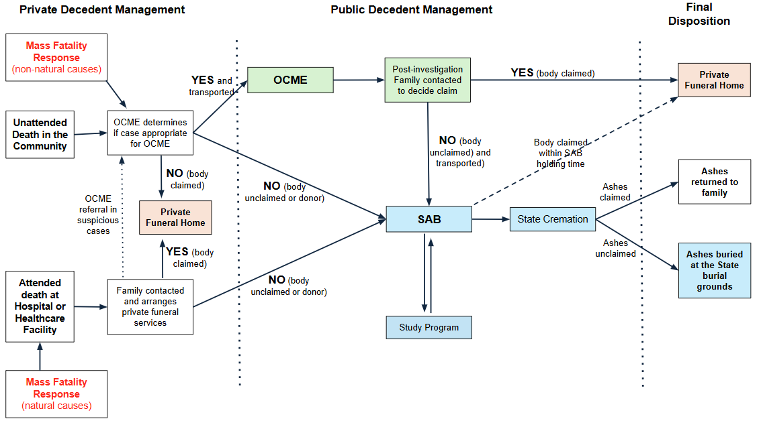
Step 10: Maryland Decedent Pathways

Slide 27
Step 11: After the Autopsy
Review and interpret ancillary test results
  Toxicology, Microbiology, Consultant reports (neuropathology, cardiovascular pathology, radiology, ocular pathology), Histology slides
Review relevant medical records
Compose the autopsy report
  Written narrative detailing the findings and conclusions of the medical examiner
  Review/correct report(s) written by fellows
Update/finalize death certificate (if pending)
Respond to inquiries received from families, law enforcement, lawyers
Represent office at review committees
Testify to findings in court/depositions
Notes:
Can take up to 90 days (or more) for us to receive all of the necessary information:
Complexity of deaths that require multi-layered testing
Ancillary testing (toxicology, histology, consultations) take weeks to months for completion
We rely on information from multiple external agencies
Cases go through QA and leadership review
National workforce shortage persists
Accuracy and precision are prioritized over TAT

Slide 28
Step 12: Cause and Manner of Death
Cause of Death: the medical condition, disease, or injury that sets into motion a series of events resulting in death
Manner of Death: describes the circumstances surrounding how the death occurs
  Homicide: death at the hands of another
  Suicide: death at the hands of oneself
  Accident: unforeseen/unexpected circumstances
  Natural: disease process or senescence
  Undetermined: when circumstances remain unclear and/or if two or more manners of death are reasonably possible
Note: Death certifications are public health determinations that are not legally binding
Notes:
If there are unresolved questions in a death that is likely a homicide, but in which an alternate theoretical, but reasonable explanation also exists, the most responsible, intellectually honest, and sound decision may be to classify the death as undetermined.
However, the impact of our determinations continues beyond certifying the cause and manner of death. Once the cause and manner of death is determined, that’s when important public health/prevention work can be done.
The circumstances that lead to fatal outcomes are rarely isolated and almost always sit at the intersection of multiple factors. We frequently see patterns involving mental health, substance use, and barriers to accessing timely and/or appropriate care.
This is also where collaboration is key: aggregation and discussion of findings with all of you can assist with visualizing clusters of preventable circumstances and patterns that single agencies alone might never see.

Slide 29
Case Correction, Appeals and PIA Requests

Slide 30
§ 5-309(d)(2) — Review and Appeals
A person in interest (as defined in General Provisions § 4–101) may request a correction to the cause or manner of death within 180 days, except in homicide cases.
If denied by the Chief Medical Examiner, the person may appeal to the Secretary of Health, who shall refer the case to the Office of Administrative Hearings (OAH).
The Administrative Law Judge (ALJ) submits findings to the Secretary, who may:
  Adopt the ALJ’s findings, or
  Reject them and affirm the original OCME findings.
Notes:
To date in 2025, there have been 8 DC contests received by OCME
Approved 2/8 changes in manner of death (both to undetermined)
Denied 6/8 requests → two have been appealed to Secretary of Health and referred to OAH
4/8 were outside of the statutory parameters (one provided new information and was amended, as above)

Slide 31
Health Gen. § 5-309(d)(2)(vi) — Required Notifications
If a final decision following administrative hearing changes the manner or cause of death to Undetermined or Homicide:
  The OCME must notify the State’s Attorney and local law enforcement in the jurisdiction of death.
  The Secretary must provide the person in interest with a certified amended death certificate at no cost.
Additional Provisions:
  The decision does not affect insurance claims or create presumptions of liability.
  Costs:
    If OCME findings are upheld → Appellant pays hearing costs.
    If overturned → Department pays.
Notes:
These changes were added in the 2023 legislative session

Slide 32
Public Information Act (PIA) & OCME Disclosure
Legal Framework
  General Provisions Art. §§ 4-101 et seq. (formerly SG §§ 10-611–628)
  Health–General § 5-310 – OCME recordkeeping
  COMAR 10.35.01.14 – Release of OCME records
Releasable
  Cause & manner of death
  Autopsy reports (unless exempt due to SAO request)
Restricted / Exempt (GP §§ 4-301 to 4-357)
  Medical or psychological information (§ 4-304)
  Law-enforcement investigatory records (§ 4-351)
  Personal privacy or confidential source material (§ 4-331)
  Attorney-client / deliberative records (§ 4-301, § 4-344)
  Autopsy photos, slides, tissues (COMAR 10.35.01.14 E)
Notes:
This slide outlines what OCME can release under the Maryland PIA and what remains restricted. The legal framework comes from PIA statute, Health General, and COMAR.
The autopsy report is public record, which includes the cause and manner of death -- the only exemption to this would be if a SAO places a hold on a case due to an “active and ongoing investigation”
All other case materials: medical/psychological information, law enforcement investigation reports, photos, slides, tissues, are protected.
These protections ensure that we comply with state law, balancing transparency with privacy for the decedent and their family

Slide 33
Opinions in Forensic Medicine

Slide 34
“But-For” Principle – Core Definition
What it Means
  The but-for principle tests whether a specific injury, condition, or event directly caused death.
  It asks:
    “Would the death have occurred but for this injury or condition?”
Key Concept:
If the death would not have occurred but for that event → the event should most appropriately be included in the cause of death.
Notes:
The “but for” principle is one of the foundations upon which we determine causation of death.
Essentially, we ask: “Would this person have died when they did, in the way that they did, BUT FOR a specific factor?”
If the answer is no - if removing that factor from the sequence would have prevented the death - then that event should be included in the cause of death.
This can be most helpful in complex cases with multiple medical conditions, injuries, or external factors.

Slide 35
Burdens of Proof and Degrees of Certainty
Degree of certainty |  | Definition/needed for
Possible | >0% | Doesn’t defy laws of science
Probable | >50% | Natural causes of death
Reasonable degree of medical certainty | >>50% | Homicides
Certainty beyond a possible doubt (impossible) | 100% | Never required
“Consistent with” | >>0% | A reasonable possibility
Notes:
Reasonable degree of medical certainty = far exceeds 50%; the assertion of this degree of certainty assumes that all other reasonable explanations and contingencies have been excluded; this is the degree of certainty when there is no good reason to believe otherwise

Slide 36
Determination of Manner of Death
Evaluation of all available evidence
  Including: decedent medical history, scene investigation, law enforcement investigative findings, and autopsy findings
Medical examiner forms a professional medical opinion on the cause and manner of death
  Note: Coroner may certify manner of death in some jurisdictions
Most challenging cases
  Presentation to colleagues at consensus conference to see if there is general agreement
  Discussion with administrative MEs (Deputies and/or Chief ME)
Some MOD certified by convention
  MVAs = accident (unless vehicle used as weapon)
  Too much alcohol in one setting = accident vs. too much alcohol over many years = natural
Manner may be changed if new information that alters the circumstances surrounding death is discovered
Notes:
Cause and manner of death are NOT indisputable statements of fact. They are statements of OPINION based on evidence found during the entire death investigation. MEs are professionally qualified and trained to evaluate all relevant information to determine cause and manner of death

Slide 37
In-Custody Death - Challenges Faced
These cases make up exceedingly small percentage of OCME average annual case volume (<1% of reported and examined cases)
Multifactorial and complex → COD and MOD not straightforward
Most challenging cases have little to no physical evidence of trauma
  Heightened reliance on circumstantial, historical, and investigative information
  Sometimes met with limited or conflicting information
Existing MOD classification becomes difficult to apply
Notes:
MOD needs to fit COD; if there is no explanation for cause, then how can manner be assigned?

Slide 38
Challenges (cont.)
Medical Examiners are not experts in LE tactics or use-of-force standards, yet our conclusions are often interpreted as commentary on them
Emotional and reputational toll significant and not unique to Maryland
  “As a profession, we have started to move the needle on how we process, talk about, and manage the vicarious trauma we absorb every day. That trauma sneaks up on us incrementally with every case, and occasionally in large doses resulting from sentinel events.”
Asked render definitive opinions in the context of medical uncertainty, social pressure, and legal scrutiny
No outcome seems to satisfy all parties involved
Notes:
Quote from Dr. Andy Baker, ME who performed George Floyd’s autopsy -- he and his office underwent extreme scrutiny surrounding Mr. Floyd’s case (which was ruled a homicide), resulting in them having to temporarily evacuate the office, move residences, and go into hiding for a period of time.
Also, remember scrutiny this office underwent surrounding Freddie Gray’s autopsy in 2015 (also ruled a homicide).

Slide 39
Deaths In Custody - National Timeline
2005-2010: Early restraint literature and rise of ExD
  American College of Emergency Physicians (ACEP) paper portraying ExD as medical entity - retracted in 2023
2010-2015: Formal guidance and early reforms
  2013: Death in Custody Reporting Act (DCRA)
  2017: NAME position paper released
2015-2020: Body cameras and ExD controversy
2020-2022: Asphyxia vs. ExD
  Professional organizations oppose ExD as diagnosis
  Emphasis on mechanical/positional asphyxia
2023-2025: Focus on restraint mechanism and systemic accountability
  Oct 2025: National Academies Report

Slide 40
Excited Delirium - Explained & Discontinued
“A state of extreme agitation, delirium, hyperactivity, sudden unexpected physical strength, and elevated temperature in individuals under the influence of cocaine, often leading to sudden death.”
Discontinued because the term lacks consistent medical criteria, and it can shift focus away from other causes such as:
restraint-associated asphyxia
positional asphyxia
underlying medical or toxicological issues

Slide 41
Excited Delirium - National Timeline
The term is widely attributed to Charles V. Wetli (forensic pathologist, Miami) and David A. Fishbain (psychiatrist) in the early 1980s at the University of Miami.
American Psychiatric Association (2017): Term is too non-specific and should not be used without validated diagnostic criteria.
American Medical Association (2021): Term is controversial and lacks defined behavioral signs or symptoms.
National Association of Medical Examiners (Mar 2023): Formally instructed members to stop using “excited delirium” as a cause of death
American College of Emergency Physicians: Did not withdraw its endorsement until 2023.
Notes:
Opportunity to create system that is modeled by other states/jurisdictions

Slide 42
Statistics

Slide 43
Average Annual Case Volume
Maryland population is 6.2 million
About 63,000 deaths annually
About 16,300 deaths referred to OCME
About 9,000 cases accepted
About 6,000 autopsies annually
Average of 16-20 autopsies a day
Homicides account for ~20-25% of each FTE ME caseload
**2023 VSA annual report
The assault (homicide) age-adjusted mortality rate was 9.1 per 100,000 population in 2023, an 25.4% decline from the 2021 rate of 12.2.
The age-adjusted mortality rate for suicide was 5.79 per 100,000 population in 2023, 40.8 % decline than the 2021 rate of 9.8 per 100,000 population**

Slide 44
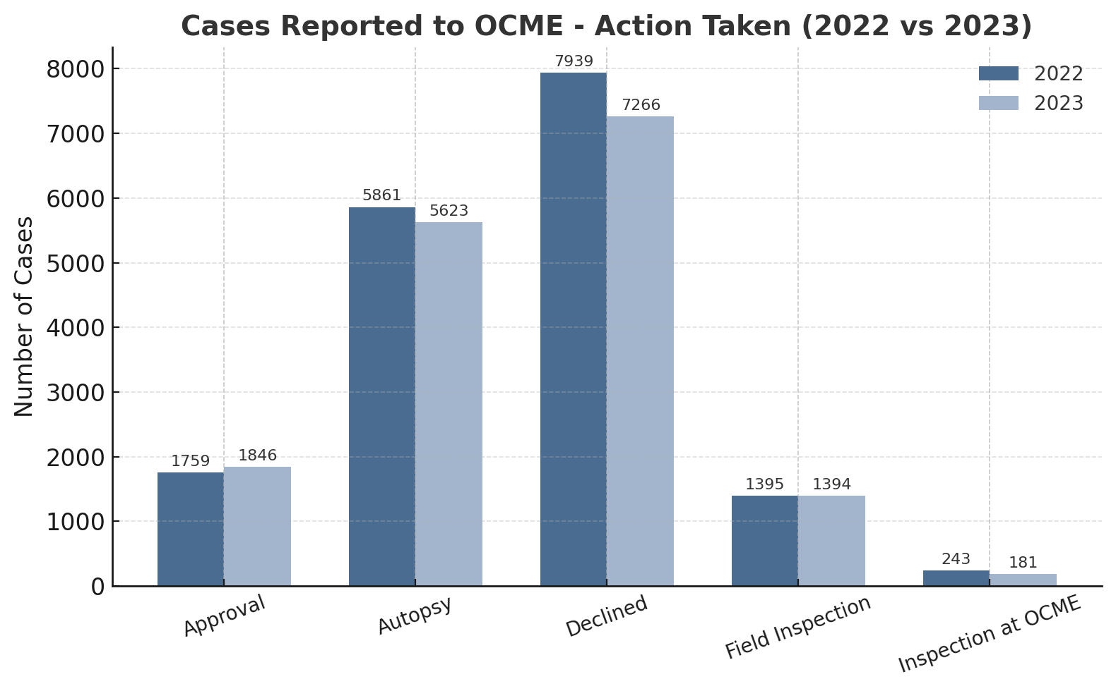
2022 and 2023-Cases Reported: Action Taken
Notes:
2023: 16279 reported
Approval: 1835
Scene Inspection: 1394
Exam: 4310 + 1194 + 178 + 97 = 5779
Declined: 7264

Slide 45
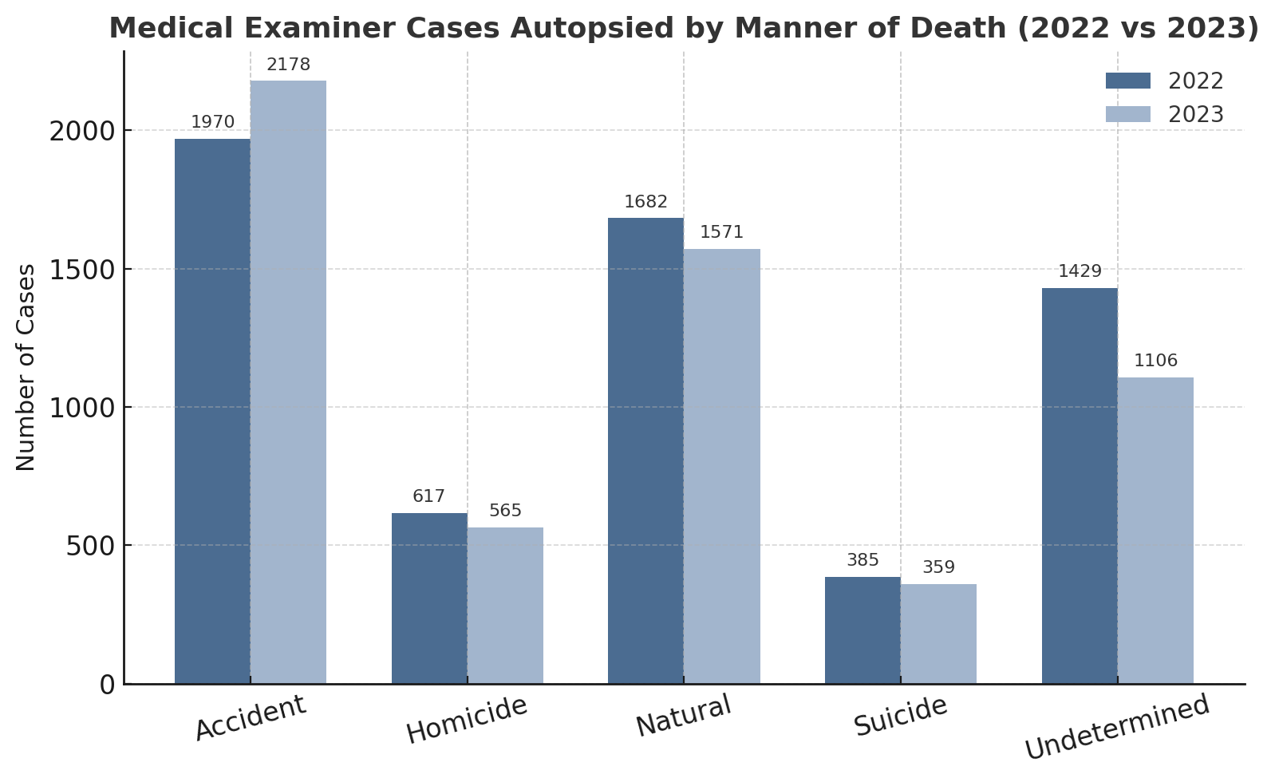
2022 and 2023-Cases Reported: Manner of Death
Notes:
NOTE: all reported cases
2023: 13 pending
Accident: 3647
Homicide: 564 -- decreased
Natural: 11225
Suicide: 474
UND: 1107

Slide 46
OCME Custodial Deaths (2019–2024)
34 Natural (CVD, Pulmonary diseases, Comorbidities)
21 Suicide (Hanging, Intentional Rx Ingestion)
12 Homicides
  3 occurred during restraint
    Note: Currently 2 homicides secondary to restraint for 2025 to date
  1 death due to dehydration/neglect while incarcerated
  8 resulting from inmate-on-inmate violence
15 Undetermined (Positive toxicology, or multiple underlying medical conditions)
7 Accident
  6 drug-related deaths
  1 fall that resulted in death
Notes:
Dependent on internal tracking system, as there is no formal way to track these deaths (no box on the DC)

Slide 47
Operational and Policy Changes Since 2019

Slide 48
Timeline of Changes
2020: Use of “Excited Delirium” ceased, three years ahead of NAME’s recommendation
2022: Maryland enacted its mandatory implicit-bias training (Health Occupations §1-225) for all medical licensees (new and renewals)
2023 Policy Updates
  All deaths during law enforcement restraint require presentation during OCME consensus conference
  OCME leadership shall review and sign all reports of deaths during law enforcement restraint
2025 Policy Updates
  Restraint autopsy protocol
  In custody photography protocol/checklist
  Investigation police involved death checklist
Request for audit materials pending
Continued effective collaboration with state and local agency partners

Slide 49
Recommendation Challenges
Outside peer review with other forensic pathology centers would be difficult due to:
  Confidentiality and statutory restrictions on release of OCME records
  Potential for liability concerns
Removing all identifying details to prevent potential bias
  May also remove essential context, resulting in an incomplete investigation
  Is not realistic in routine practice

Slide 50
Possible Future Directions
Utilize/modify existing legislation (PMEC) to integrate a multidisciplinary review board
Foster collaboration across ME, law enforcement, legal system, clinical practitioners, and public health
Standardize investigative process for all restraint/ in-custody deaths in Maryland
Promote transparency and shared accountability
Provide recommendations for a data-driven, trust -centered structure for future cases
Notes:
As Maryland continues to strengthen our approach to deaths in custody, the OCME remains committed to being reliable, objective, and thorough in these investigations.
As always, we ground our discussions in respect for the decedents and families behind each individual case. We strive to honor them by focusing on prevention and systemic improvements that ultimately save lives.
We look forward to continued collaboration, embracing this opportunity to be at the forefront of developing standards and recommendations for the investigation of custodial deaths.

Slide 51

Thank you
Stephanie A. Dean, M.D.
deans@ocmemd.org
410-333-3225
https://health.maryland.gov/ocme/Pages/Home.aspx

