Slide 1

Presentation to the Maryland Commission on Juvenile Justice Reform and Emerging and Best Practices
April 10, 2025

Slide 2
The Juvenile Justice Reform Council 2019-2021: Mission, Process and Recommendations

Slide 3
House Bill 606 (2019) charged the Council's to:
Use data-driven approaches to develop a statewide framework of policies to invest in strategies to increase public safety and reduce recidivism of youth offenders’
Research best practices for the treatment of juveniles who are subject to the criminal and juvenile justice systems;
Identify and make recommendations to limit or otherwise mitigate risk factors that contribute to juvenile contact with the criminal and juvenile justice systems

Slide 4
Technical assistance: JJRC instructed to engage a TA provider to assist the Council in evaluating reform opportunities
Vera was selected to support the work through data research methods, emphasizing racial and ethnic disparities that permeate juvenile justice systems.

Slide 5
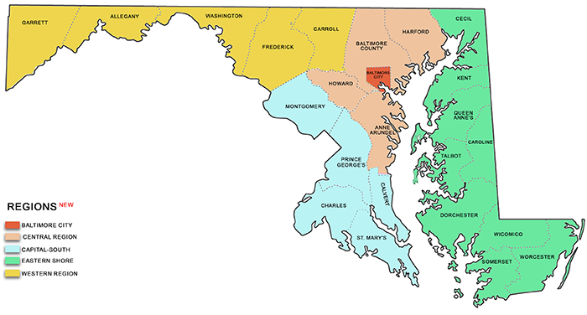
Gathering input: Surveys and Listening Session
Vera surveyed Council members and held eight listening sessions across each of Maryland's regions. The listening sessions included 530 people.
From these listening sessions, Council surveys and discussions, seven priorities emerged:
Ou

Slide 6
Priorities for the Council's work
Reducing juvenile secure commitments and detention
Expanding diversion authority and practice
• Examining probation terms and reducing their length
• Changing the minimum age of jurisdiction
Youth charged as adults: Exploring changes to statutory requirements for adult court jurisdiction
Services: Ensuring that individuals who are diverted or otherwise maintained in the community receive quality, culturally competent services (Did not reach in fall of 2020)
Education: Expanding and improving vocational and non-traditional high school educational options for youth in the community and in DJS facilities, to foster greater youth engagement (Did not reach in fall of 2020)

Slide 7
Process
For each issue, Vera presented a data analysis based on DJS and court data, and a policy overview.
Council asked questions
Council members were asked to prepare proposals on the issue, based on the presented materials, discussion, and their own expertise
At the next meeting, the proposals were discussed, potentially amended, and voted upon.

Slide 8
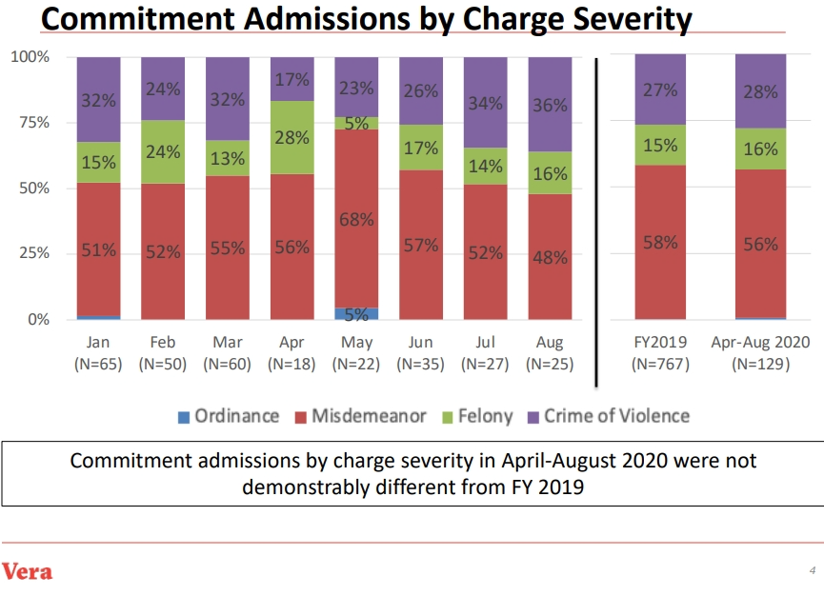
Example: Out of Home Commitments

Slide 9
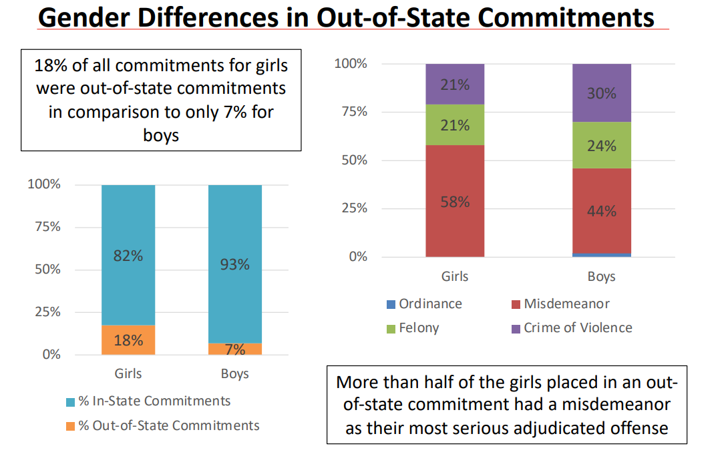
Gender disparities

Slide 10
Out of Home Commitments: Policy comparisons
New York: Close to Home
Illinois: Juvenile Redeploy Illinois, and ILCS 405/5-710
California: Juvenile Justice Realignment

Slide 11
Result: Two Recommendations on Out of Home Commitment
Recommendation 11.
Amend State law to prohibit commitment of a child to DJS if the child is:
    adjudicated delinquent for an offense that would be a misdemeanor if committed by an adult, unless the adjudication is for a second or subsequent offense involving a firearm;
    found in violation of community supervision for a technical violation, as defined in § 6-101 of the Correctional Services Article.
Recommendation 12.
DJS should establish a plan to transition from the current slate of committed facilities to ensure every region has access to nonresidential and residential community-based services that employ evidence-based, culturally competent programming.

Slide 12
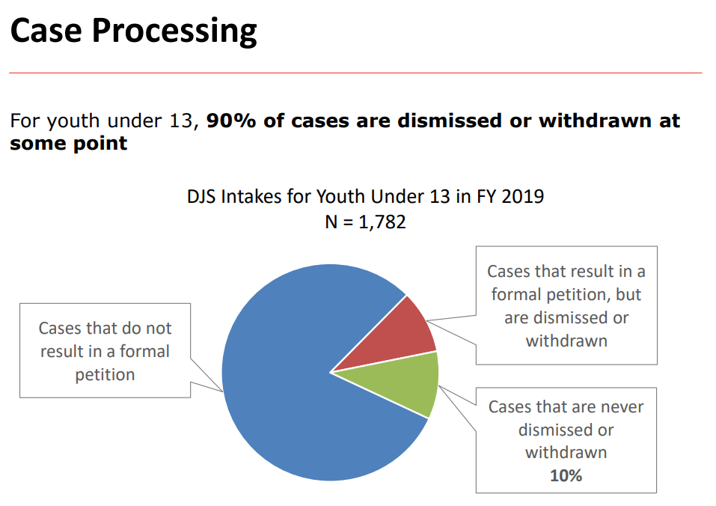
Example: Minimum Age of Jurisdiction

Slide 13
Minimum Age of Jurisdiction: Policy Discussion
As of fall of 2020, four states (Utah, Massachusetts, California and Nebraska) had created a minimum age of 11 or 12
Neuroscience: Pre-teens haven’t reached a level of neurocognitive development necessary to be held legally culpable for their actions.
Legal competence: Children have diminished ability to understand the charges against them, their rights, their role in an adversarial system, and the role of adults in this system.
Harmful effects of juvenile justice experience: To children with many adverse childhood experiences, experience of the juvenile system is damaging, leads to poor outcomes.
Collateral consequences: Missing school, family disruptions
Poor use of resources: Most cases for children younger than 13 are dismissed
International standards: United Nations Convention on the Rights of the Child sets minimum age at 12; the most common age cross nationally is 14

Slide 14
Results
Recommendation that that juvenile court does not have jurisdiction over a child under the age of 10 years old.
The juvenile court does have jurisdiction over a child at least 10 years old alleged to have committed limited crimes.
The juvenile court should have jurisdiction over a child at least 13 years old alleged to have committed a delinquent act.

Slide 15
Questions?
Marta Nelson
mnelson@vera.org

Slide 16

Ending Girls’ Incarceration

Slide 17
There are
42,000
girls' detention admissions nationwide each year – largely due to low level offenses.

Slide 18

The majority of girls are arrested and detained for low-level offenses that pose no risk to public safety but are rooted in experiences of trauma, abuse, race, and gender discrimination.

Slide 19
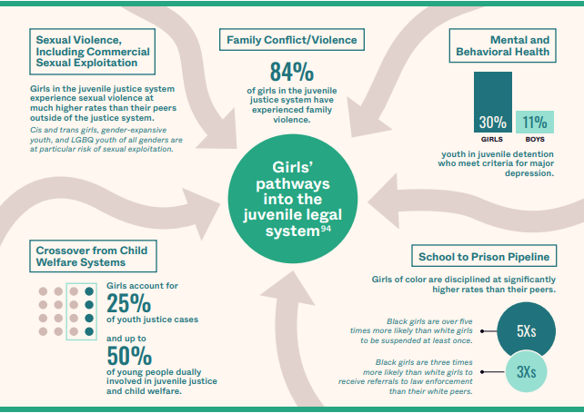

Slide 20

EGI Partner Jurisdictions
NYC: 70% drop in annual girls’ detention admits; Two years of 2 or fewer girls in placement at once.
Santa Clara County (CA): Over 60% drop in annual girls’ detention admits; 1+ year with no girls in secure placement.
Hawaii: Zero girls at only correctional facility for the first time in history
Imperial County (CA): Maintaining functional zero girls in juvenile hall
NORTH DAKOTA
MAINE
CALIFORNIA
(Imperial, Los Angeles, Sacramento, San Diego, and Santa Clara counties)
NEW YORK CITY
HAWAII
Notes:
LINDSAY

Slide 21
Ending Girls’ Incarceration in California Action Network Counties
(Imperial, Los Angeles, Sacramento, and San Diego)
Common themes emerging across sites:
Racial disparities
Girls held for their own safety
Lack of gender-responsive diversion and prevention programs
Crossover from child welfare
Housing instability and placement challenges
Concerns about sex trafficking
Notes:
LINDSAY

Slide 22
Ending girls' incarceration by advancing freedom
Principle 1
Ensure that incarceration is used as a last resort or not at all by explicitly prohibiting any confinements based on young people’s service and safety needs, status offenses, technical violations of probation, misdemeanors, and other offenses that evidence shows can be safely addressed in the community.
Principle 2
Invest in a continuum of community resources—including prevention, diversion, alternatives to incarceration, and community reintegration programs—to meet the needs and challenges of girls and gender expansive youth with increased support instead of punishment.
Principle 3
Draw on interagency collaboration, youth leadership, and inclusive community partnerships to stem the criminalization of girls and gender expansive youth by government systems, including education, mental health, immigration, and child welfare.

Slide 23
Recommendations for statewide change
Support and champion legislation to limit circumstances in which young people can be arrested or detained
Support and champion legislation aimed at eliminating detention for technical violations of probation
Incentivize and support local work to end girls’ incarceration through access to funding for programming and training

Slide 24
Recommendations for local policymakers
Prevent confinements based on concerns for girls’ safety and technical violations and eliminate confinement for low-level charges
Invest in gender-responsive programming to create off-ramps from the youth legal system that do not require formal probation supervision for youth to access
Prevent net-widening and crossover from child-serving systems by establishing cross-agency standards and investing in non-law-enforcement crisis responses
Invest in collaborative leadership through diverse and multidisciplinary workgroups that facilitate the sharing of power and resources with those most impacted.

Slide 25
Questions?
Sarah Derrigan
sderrigan@vera.org

