Slide 1
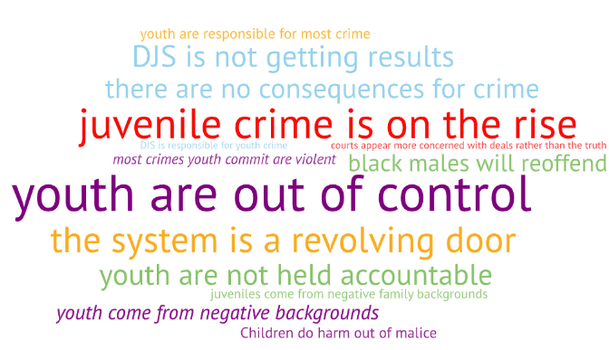

Slide 2
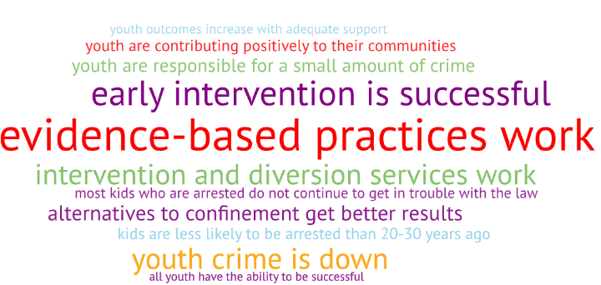

Slide 3
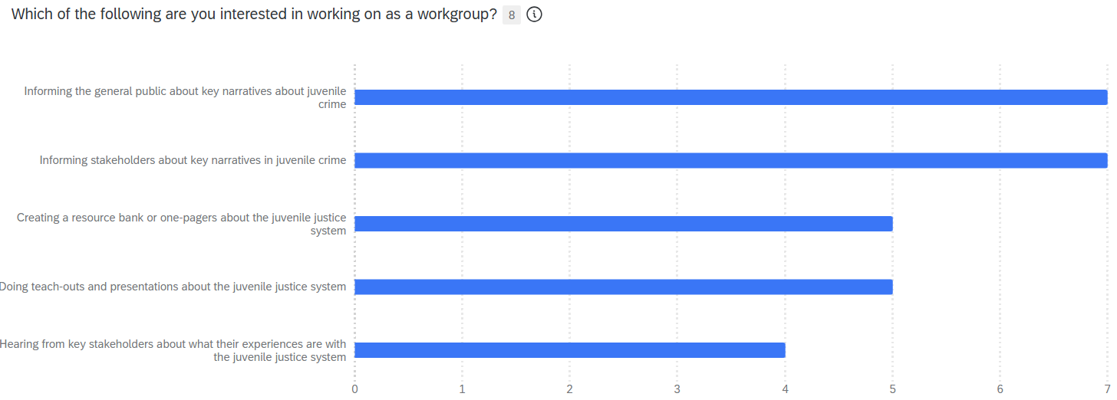

Slide 4
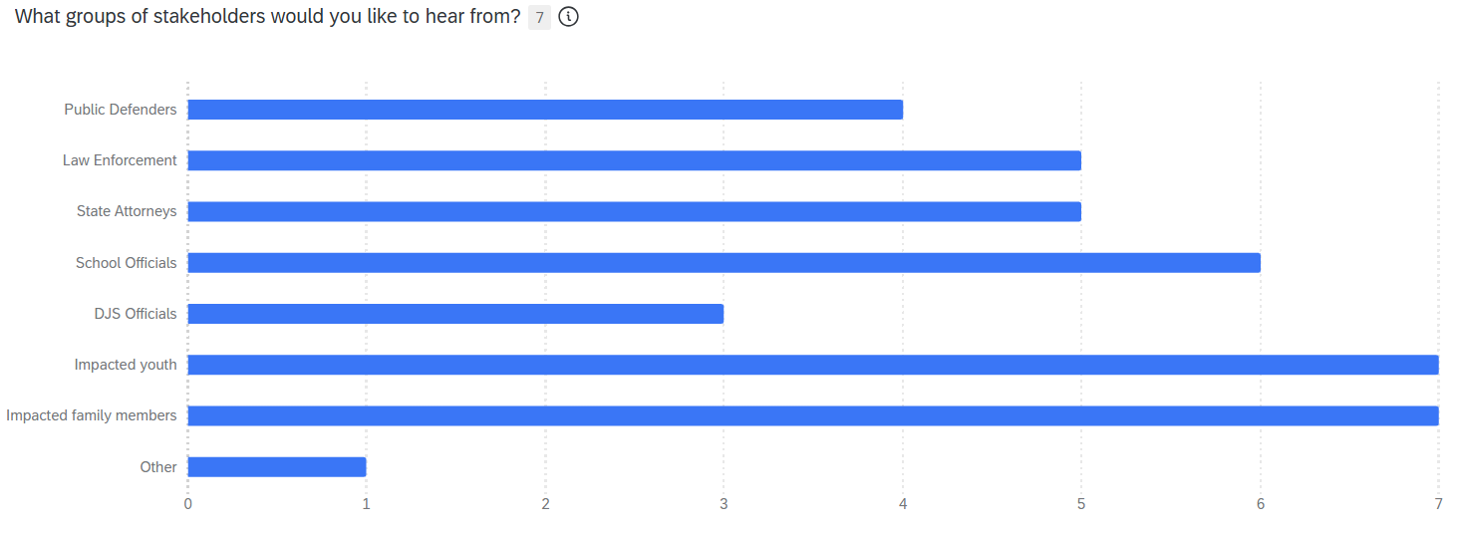

Slide 5
Questions
Resources
  Where do resources exist?
  Where are their gaps in resources?
  How long does it take to get resources?
Differences in case decisions and programming
Multiple system involvement
Intake process

Slide 6
Misunderstandings
History and purpose of the juvenile justice system and components
Function of different players in the juvenile justice system
Punitive punishment works best
Nothing happens to youth involved in DJS system

