Slide 1
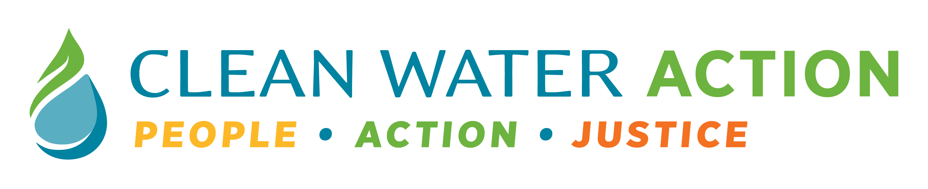
Water Security, Equity and Policy Gaps in Maryland
Gabrielle Sanchez

Slide 2
Why Water Security Matters
About 5.1 million Maryland residents rely on public drinking water systems, while over 1 million depend on private wells.
Safe, reliable water is essential for health, food production, economic growth, and ecosystem stability.
Yet, access to safe and affordable water is increasingly threatened across Maryland due to contamination and system vulnerabilities.

Slide 3
What is Water Insecurity ^{[Source]}
Water insecurity is the inability to consistently access and benefit from safe, clean, and acceptable water for a healthy life.
Household water insecurity affects all household uses, including drinking, cooking, hygiene, and sanitation.
Water insecurity is projected to increase worldwide, including in high-income countries like the United States.
Microbiological (coliform, E. coli) and chemical (PFAS) contaminants, along with climate change and aging infrastructure, are compounding risks to water quality and supply.

Slide 4
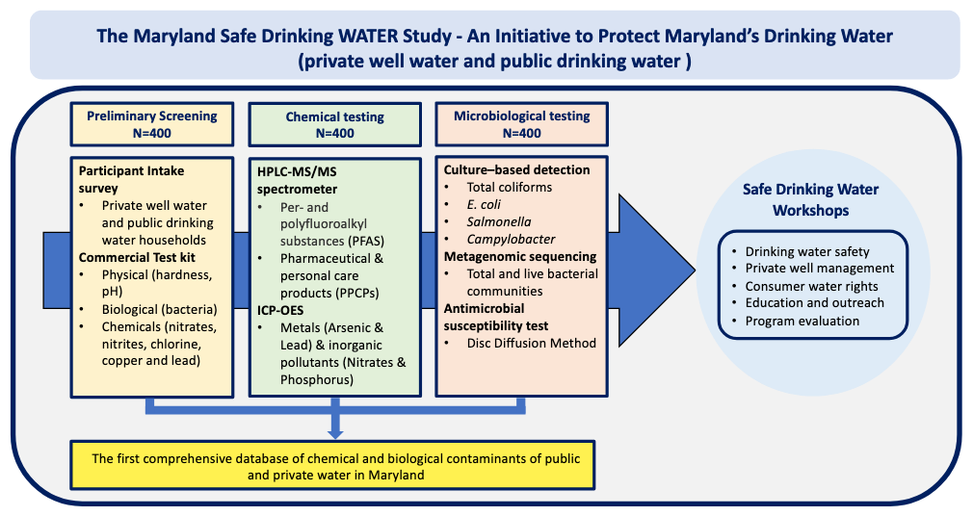

Slide 5
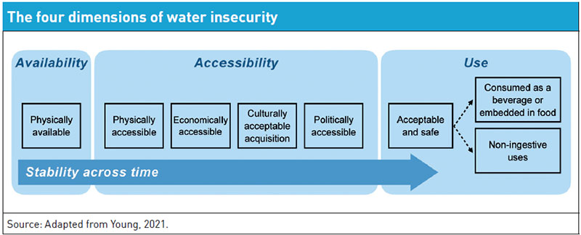
[source]
Water insecurity occurs when any one of these dimensions is compromised.

Slide 6
Water Insecurity in the United States
A growing number of households:
  Cannot afford their water bills
  Rely on water contaminated with lead, harmful chemicals, and bacteria contaminants
  Avoid drinking tap water due to concerns about safety, quality, or source
National averages mask inequities:
  Access and quality vary widely by race, income, and geography
  Low-income, Black, and Hispanic households are disproportionately affected by systems with water quality violations

Slide 7
Water Contamination in Maryland
In 2022, E. coli contamination was detected in a portion of the city’s water system affecting about 1,500 residents.
Residents were advised to take precautions, such as avoiding tap water for drinking or cooking while testing and remediation are underway. ^{[source]}
Baltimore County tested 89% of its schools, finding that 30% of drinking fountain samples exceeded lead safety thresholds, which is more than double the state average. ^{[source]}
Baltimore-area watersheds and the Chesapeake Bay region continue to face pollution pressures, including stormwater runoff and sanitary sewer overflows during heavy rain.

Slide 8
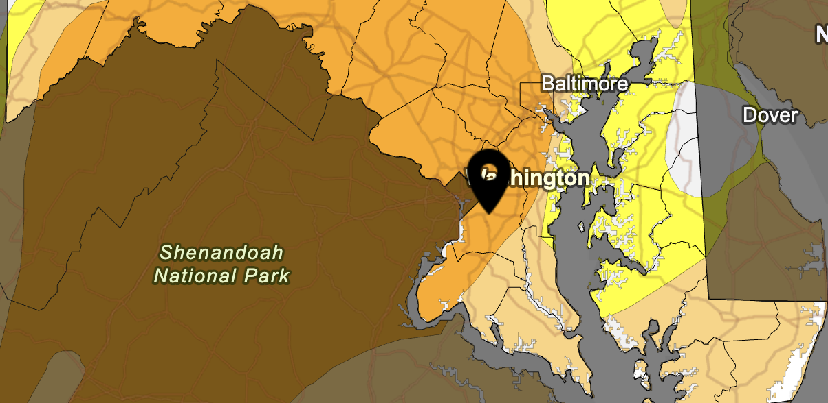
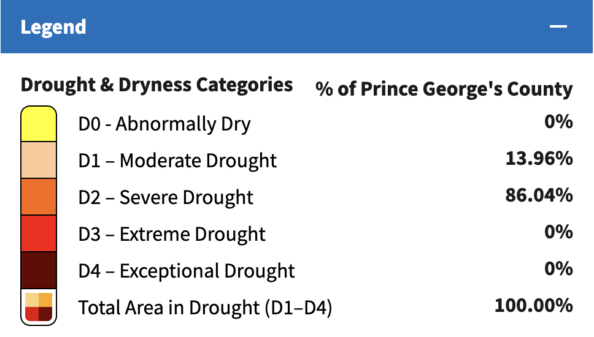
Effects of Drought
Depleting surface water and groundwater aquifers continues to cause water supply shortages, reducing water quality, and damaging ecosystems.
Source

Slide 9
Why This Matters for Equity in Maryland
Water insecurity disproportionately affects low-income households and communities of color in Maryland.
In Baltimore, water bills rose dramatically over 2 decades while incomes grew far less.
  Unaffordability concentrated in low-income, majority-Black neighborhoods
  Shutoffs and tax-sale-related impacts map onto historically redlined areas
Many Maryland families face:
  High and rising water bills
  Aging water infrastructure and lead service lines
  Distrust of tap water due to past and ongoing contamination concerns

Slide 10
Cumulative Effects on Households with Children ^{[source]}
Water insecurity adds cumulative stress for Maryland households with children, compounding food insecurity, housing instability, and rising utility costs.
Avoidance of tap water due to safety concerns increases reliance on bottled or sugary beverages, raising costs and reducing consistent hydration.
Water insecurity affects children across home and school settings, contributing to dehydration, difficulty concentrating, and poorer health and educational outcomes.
Reduced consumption of fluoridated tap water increases the risk of dental caries, deepening oral health and broader health inequities among children.

Slide 11
Gaps in Policy
Maryland does not have a uniform, statewide mandate providing consistent water bill assistance to all low-income owners and renters.
Baltimore’s Water4All is only eligible for household incomes 200% below the federal poverty line. ^{[source]}
  That is $66,000 for a 4-person household
  The cost of living in Baltimore City for a family of 4 is about the same as the national average ($80,000) , while utilities are about 17% higher than the national average ^{[source]}
Water shutoff policies leave many households vulnerable.^{[source]}
  Only 53% of municipalities require written notice before shutoffs
  Many impose disconnection and reconnection fees, compounding financial hardship for families already struggling to afford water service.

Slide 12
Gaps in Policy - Schools
School water safety policy intent like routine lead testing and remediation doesn’t consistently translate into safe, usable drinking water at school.
  Maryland law requires all schools served by public water to test every drinking water outlet every three years, but some districts have tested far fewer schools than required (e.g., Baltimore City tested only ~14% of its schools in the most recent cycle despite the state mandate) ^{[source]}
Follow-up remediation varies widely by district:
  Some systems (e.g., Baltimore County) rely primarily on providing bottled water rather than more protective measures like shutting off contaminated outlets or replacing lead-bearing plumbing, leaving students exposed longer. ^{[source]}

Slide 13
Gaps in Policy – Well Water ^{[source]}
Private wells remain a major equity blind spot.
  Policy largely assumes public-system protections, while many Marylanders rely on wells with uneven testing and support.
Research in Maryland has detected contaminants (e.g., coliform/E. coli and PFAS) in both public and private supplies, underscoring that “safe water” policy protections don’t reliably reach households outside regulated systems.

Slide 14
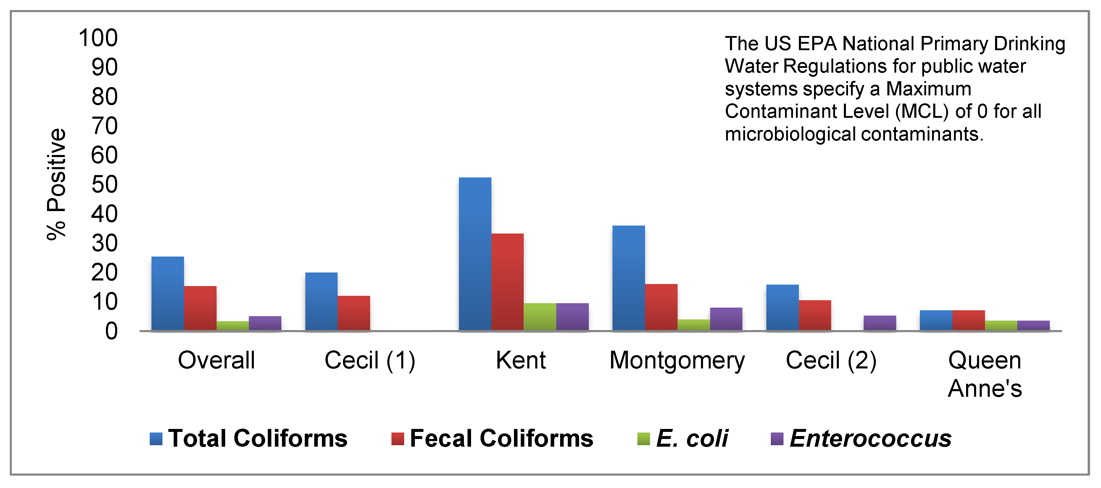
Prevalence of Microbiological and Chemical Contaminants in Private Drinking Water Wells in Maryland ^{[source]}

Slide 15
Prevention
Public water providers should incorporate income-based rate structures and discontinue punitive practices such as tax liens and water shut-offs.
Policy should protect Marylanders who use well water (e.g., routine testing and support for remediation).
Expand routine testing for lead, PFAS, and microbial contaminants in schools, childcare centers, and private wells, with timely public reporting and clear remediation requirements.
Treat water insecurity like food insecurity; track it with consistent metrics, incorporate it into public health and education planning, and center communities most affected in decision-making.
  Addressing water insecurity alongside food insecurity strengthens whole-child and whole-family outcomes.

Slide 16
Thank you gsanchez@cleanwater.org

