Slide 1



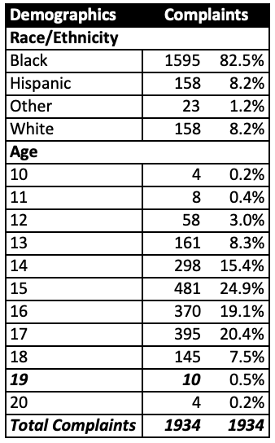
Juvenile Complaints with Reportable Offenses
DJS DATA FY 2025
1,934
Youth were referred to DJS with a reportable offense in FY2025 (July 1, 2024 - June 30 2025). This was 15% of all complaints
92% were youth of color, which is a higher proportion that the 78% of all complaints
Age profile is very similar to overall complaints

Slide 2
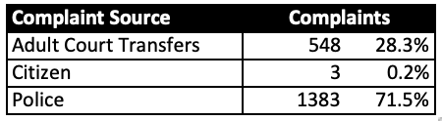
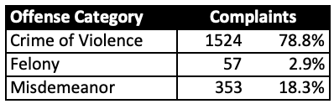
Complaints by Source and Category
DJS DATA FY 2025
28% of complaints began as adult court charges which were subsequently transferred to juvenile court jurisdiction. This compares with 4.6% of all complaints.
This count excludes those not transferred to juvenile court.
79% are for crimes of violence, compared to 14% of all complaints.

Slide 3
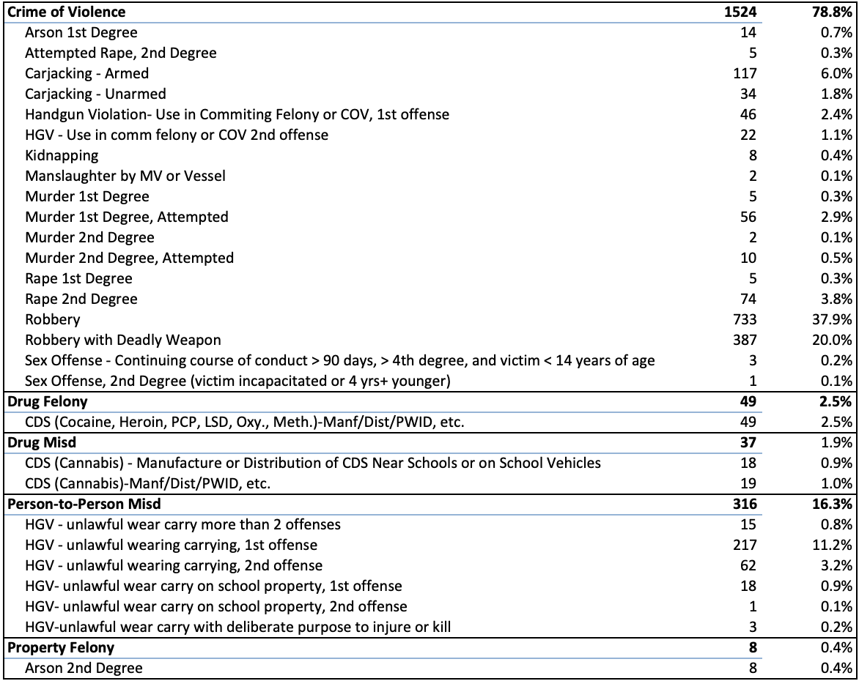
Complaints by Most Serious Offense
DJS DATA FY 2025

Slide 4
Complaints by Jurisdiction
DJS DATA FY 2025
County of Jurisdiction | Complaints |  |  | County of Jurisdiction | Complaints
Allegany | 12 | 0.6% |  | Harford | 37 | 1.9%
Anne Arundel | 94 | 4.9% |  | Howard | 56 | 2.9%
Baltimore City | 610 | 31.5% |  | Kent | 3 | 0.2%
Baltimore County | 383 | 19.8% |  | Montgomery | 236 | 12.2%
Calvert | 6 | 0.3% |  | Prince George`s | 312 | 16.1%
Caroline | 7 | 0.4% |  | Queen Anne`s | 1 | 0.1%
Carroll | 8 | 0.4% |  | Somerset | 6 | 0.3%
Cecil | 13 | 0.7% |  | St. Mary`s | 14 | 0.7%
Charles | 55 | 2.8% |  | Talbot | 4 | 0.2%
Dorchester | 16 | 0.8% |  | Washington | 15 | 0.8%
Frederick | 17 | 0.9% |  | Wicomico | 18 | 0.9%
Garrett | 3 | 0.2% |  | Worcester | 8 | 0.4%

Slide 5
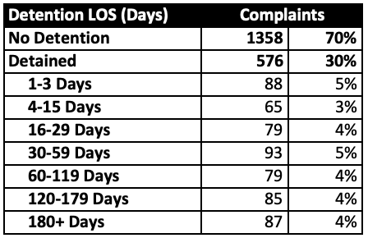
Complaints by Days Detained
DJS DATA FY 2025
70% of youth are not detained at the time of the juvenile complaint.
This count includes days spent in DJS detention while awaiting adult court transfers, but only for those transferred.
30% of youth are detained at the time of complaint, with a broad range of lengths of stay.

Slide 6
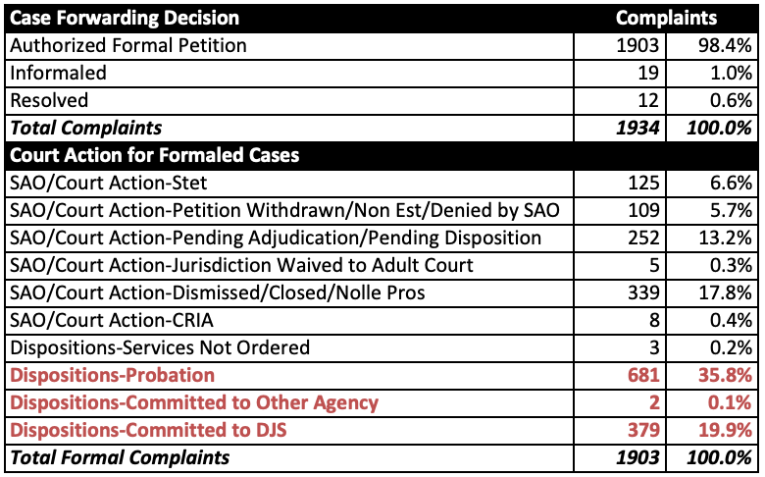
Complaints by Case Outcomes
DJS DATA FY 2025
98.4% of cases were forwarded to court by DJS Intake
.
13% of cases were still pending at the time this data was run.
Of the cases not pending, 36% did not have a disposition.

Slide 7
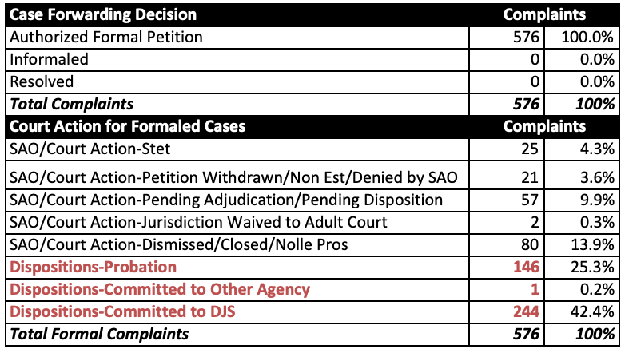
Detained Youth Case Outcomes
DJS DATA FY 2025
All cases were forwarded to court by DJS Intake
.
9.9% of cases were still pending at the time this data was run.
Of the cases not pending, 25% did not have a disposition.

Slide 8
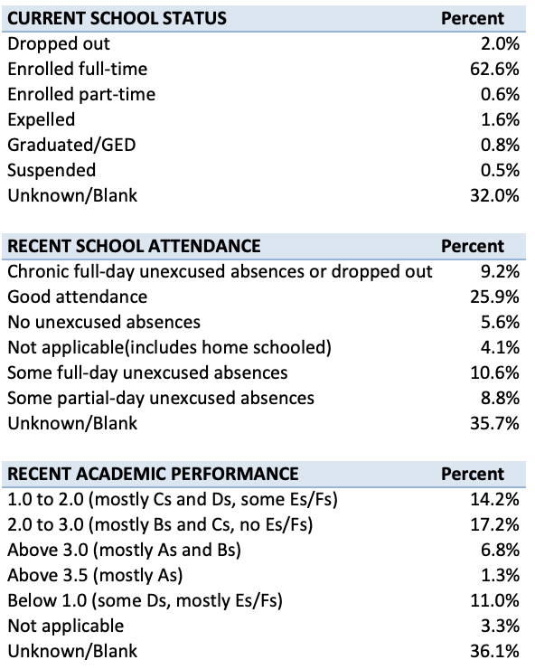
Intake Needs Assessment Information
DJS DATA FY 2025
66% of complaints had an Intake Decision Tool risk/needs assessment done. (Not completed for TOJ, VOP, or FTA cases)
Even when completed, there are often answers of “unknown” or questions may be left blank.

Slide 9
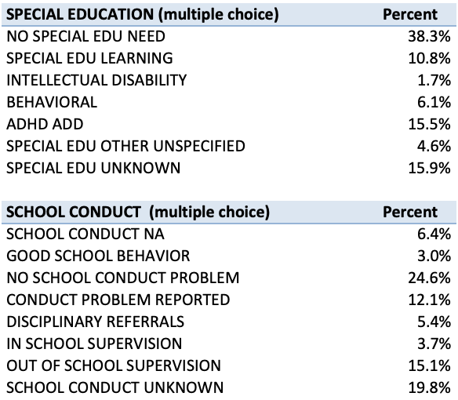
Intake Needs Assessment Information
DJS DATA FY 2025

Slide 10


Process Overview
DJS DATA FY 2025
Information Sharing
Information Gaps

