Slide 1
Employment and Wages for Returning Citizens in Correctional Education Programs

Slide 2
Notes on Data Collection
These charts and discussions are based on an analysis done by the Maryland Longitudinal Data System Center. The purpose of the charts and discussions is to summarize information provided to the Prison Education Delivery Reform Commission. and are not products of the MLDS Center.
Data Citation:
MLDS Center (2024). Data Tables for Maryland Department's of Labor and Public Safety and Correctional Services. Baltimore, MD: Maryland Longitudinal Data System Center.

Slide 3
Limitations
No correctional education completion record does not mean that an incarcerated individual does not have outside education, such as a high school diploma, certifications, or a college degree.
Wage visibility does not directly translate to employment. Returning citizens may be engaged in alternate forms of labor that are not captured by the Department of Labor.

Slide 4
Post-Release Employment
How many returning citizens find employment in the first year of release by program?

Slide 5
Percent of Returning Citizens with Wage Visibility in the First Year Post-Release by Program Type and Number of Fiscal Quarters Reported
Key Takeaways:
Completing a CE program is associated with higher wages post-release
Completing a transitional AND national occupational program is associated with higher wages post-release

Slide 6
Post-Release Employment
How many returning citizens find employment three years post-release by program?

Slide 7
Percent of Returning Citizens with Wage Visibility Three Years Post-Release by Program Type and Number of Fiscal Quarters Reported
Key Takeaways:
Completing a CE program is associated with higher wages post-release
Completing a transitional AND national occupational program is associated with higher wages post-release
Overall employment went down, though the percentage of those with consistent employment was only slightly reduced

Slide 8
Post-Release Employment
How does completing different correctional education programs affect employment in the first year post-release?

Slide 9
Percent of Returning Citizens with Wage Visibility in the First Year Post-Release by Program Type, Correctional GED Completion, and Number of Fiscal Quarters Reported
Key Takeaways:
Obtaining a CE GED was associated with higher rates of wage visibility
Highest rate of wage visibility was seen in those who had a CE GED, Occupational/Transitional Certificate, and Transitional Certificate

Slide 10
Post-Release Employment
How does completing different correctional education programs affect employment three years post-release?

Slide 11
Percent of Returning Citizens with Wage Visibility Three Years Post-Release by Program Type, Correctional GED Completion, and Number of Fiscal Quarters Reported
Key Takeaways:
Obtaining a CE GED was associated with higher rates of wage visibility
Highest rate of wage visibility was seen in those who had a CE GED, Occupational/Transitional Certificate, and Transitional Certificate
Overall employment went down, though the percentage of those with consistent employment was only slightly reduced

Slide 12
Wages
What are the wages of incarcerated individuals who obtain employment upon release?

Slide 13
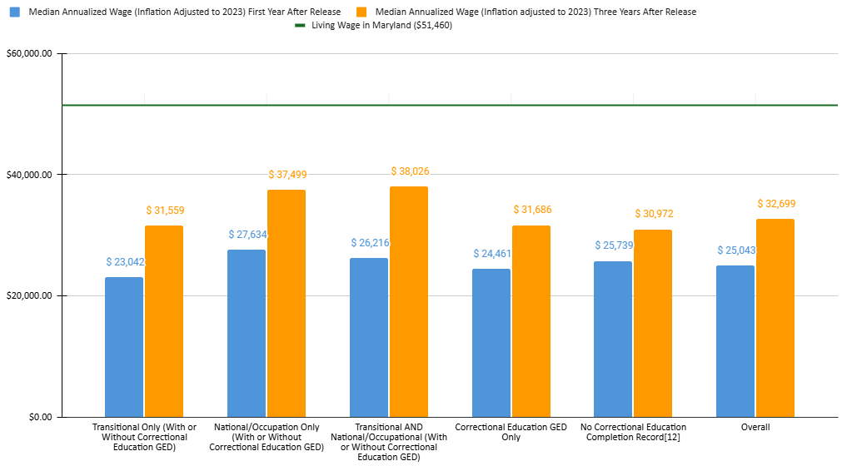
Median Annualized Wage of Those with Wages in All Fiscal Quarters by Program Type and Time Post-Release
Key Takeaways:
Wages increase over time, indicating steady employment
No category achieved the Maryland living wage, indicating limited upwards mobility
Completing a CE program resulted in higher wages, especially when completing more than one program

Slide 14
Post-Release Employment
Where are returning citizens finding employment one year post-release?

Slide 15
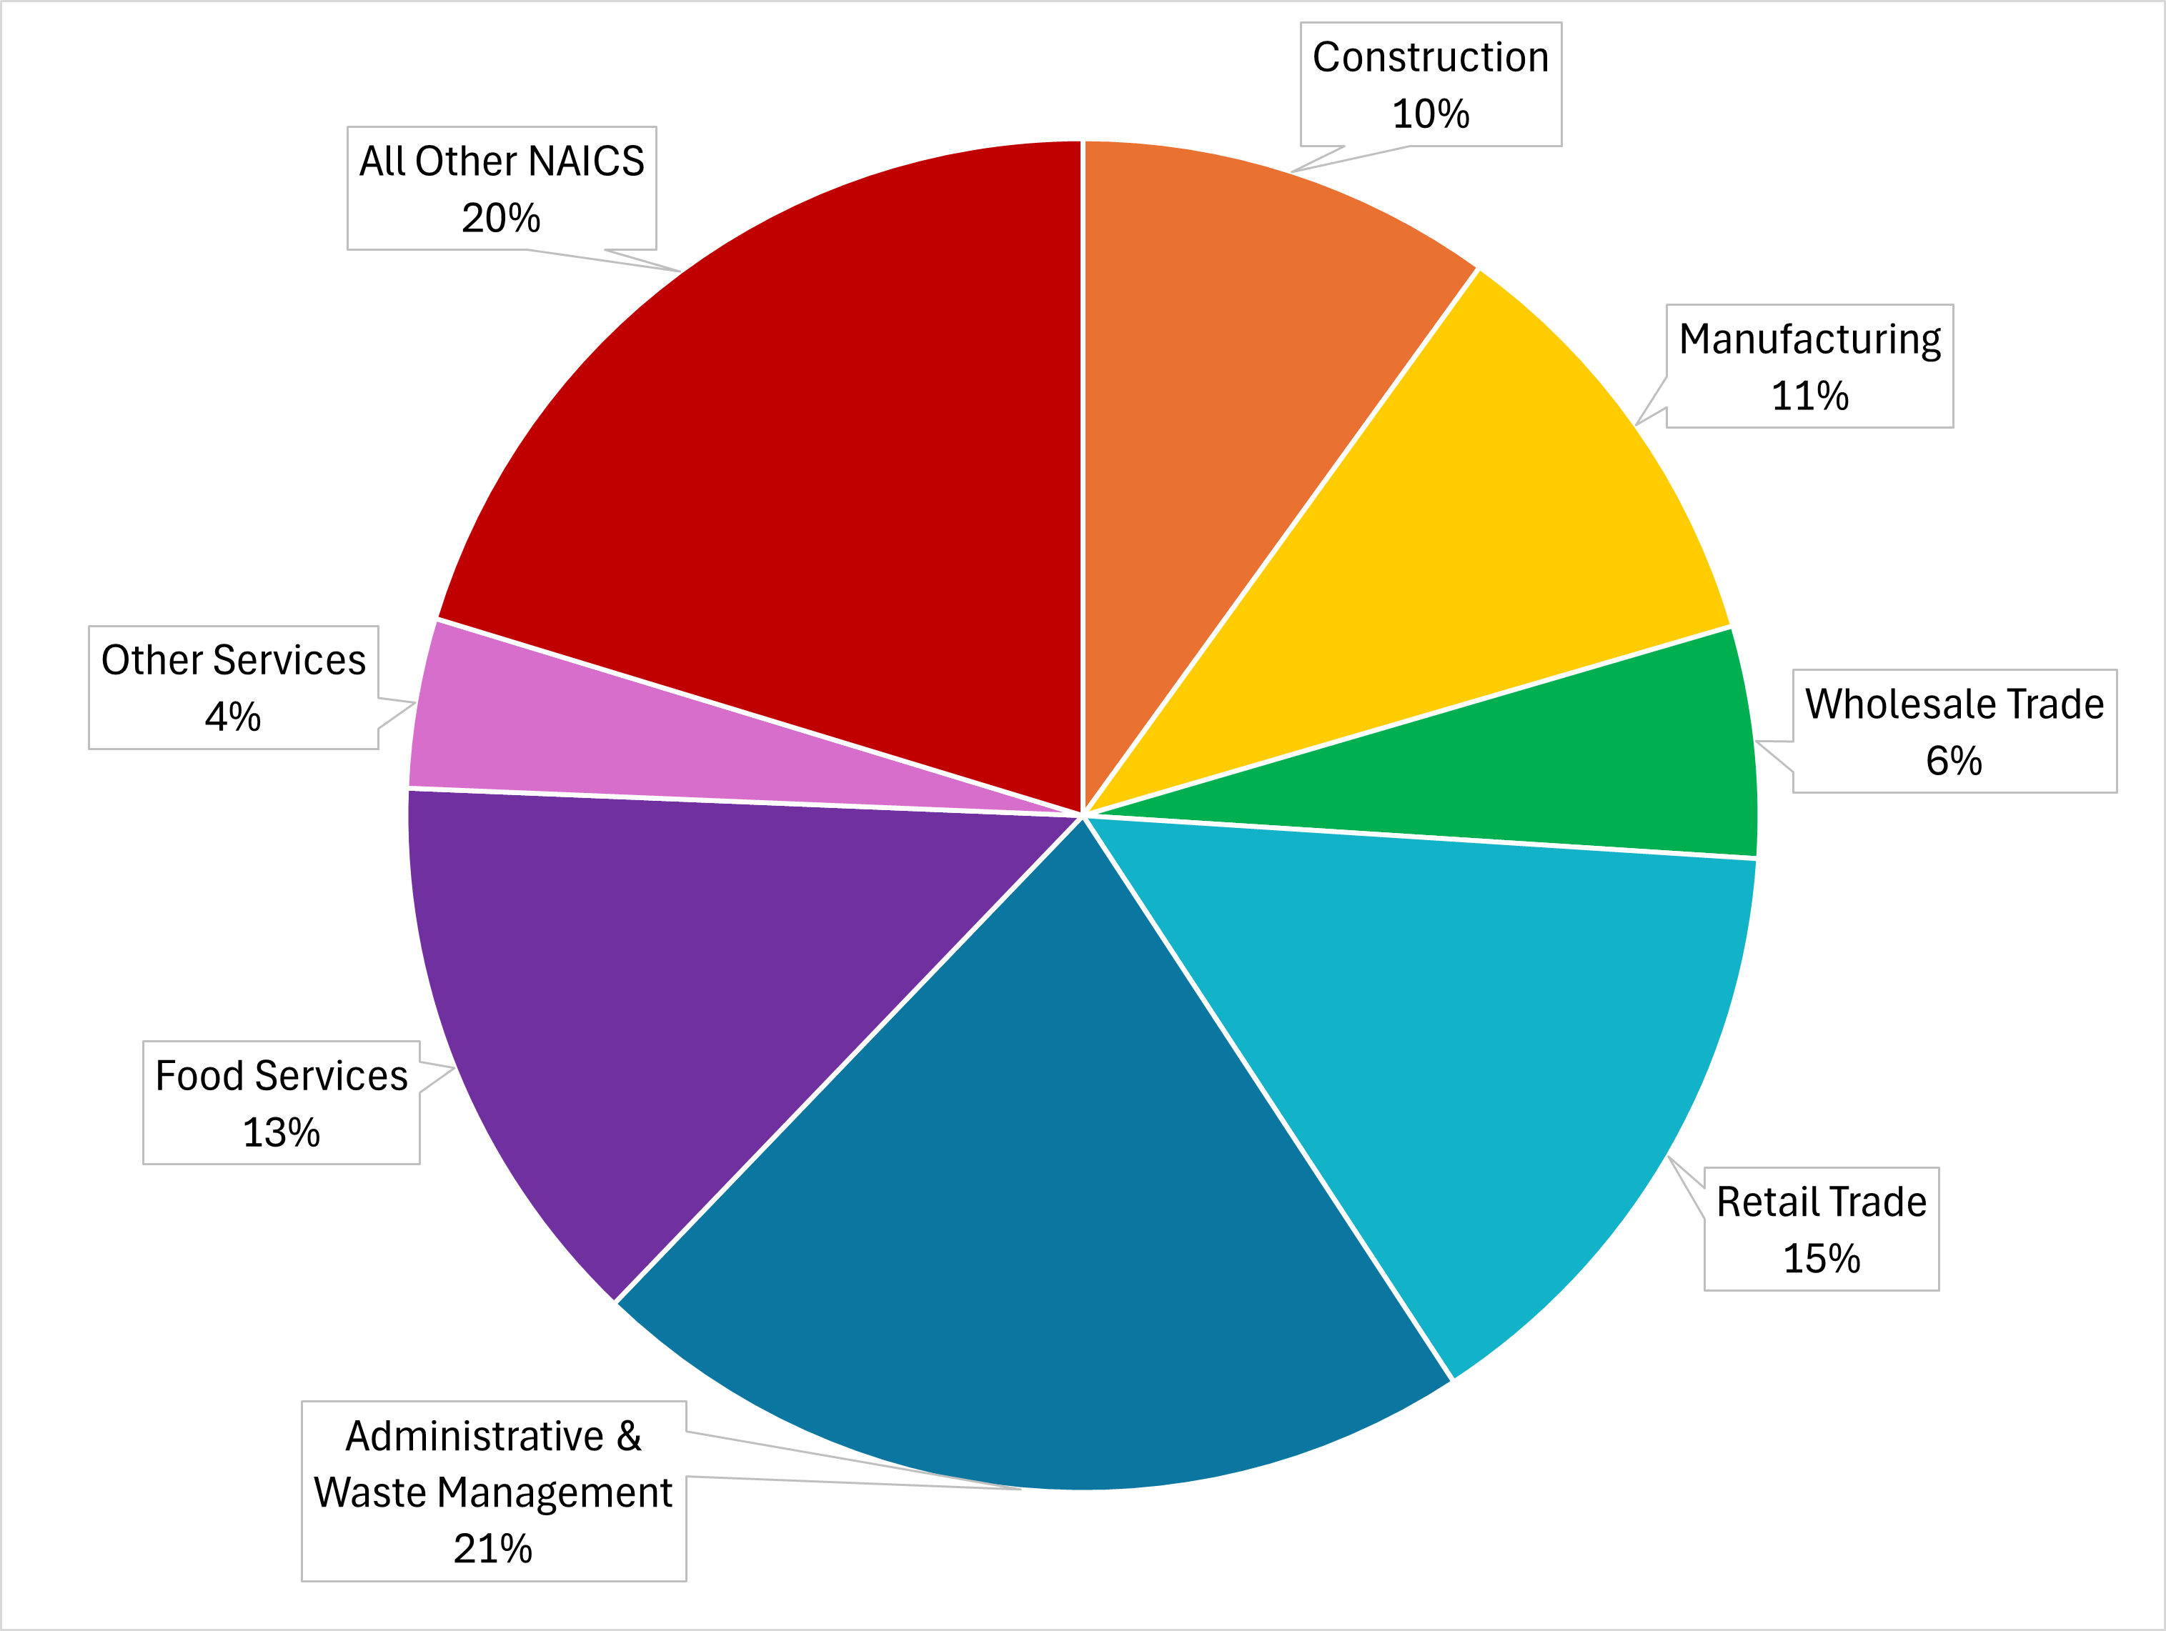
Proportion of Returning Citizens in Each Industry One Year Post-Release

Slide 16
Wages
What is the difference in wages for those able to obtain employment post-release by industry?

Slide 17
Median Quarterly Wage of Returning Citizens One Year Post-Release by Industry and Program Type
Key Takeaways:
Obtaining a national or occupational certificate more frequently leads to higher wages than only obtaining a transitional certificate
Obtaining a national or occupational certificate leads to higher wages in industries that may require training

