Slide 1


Higher Education Systems in Prison and Campus Reentry:
A National Landscape Analysis
June 25, 2026
Britany Gatewood, Ph.D. | Research Associate, NASH

Slide 2

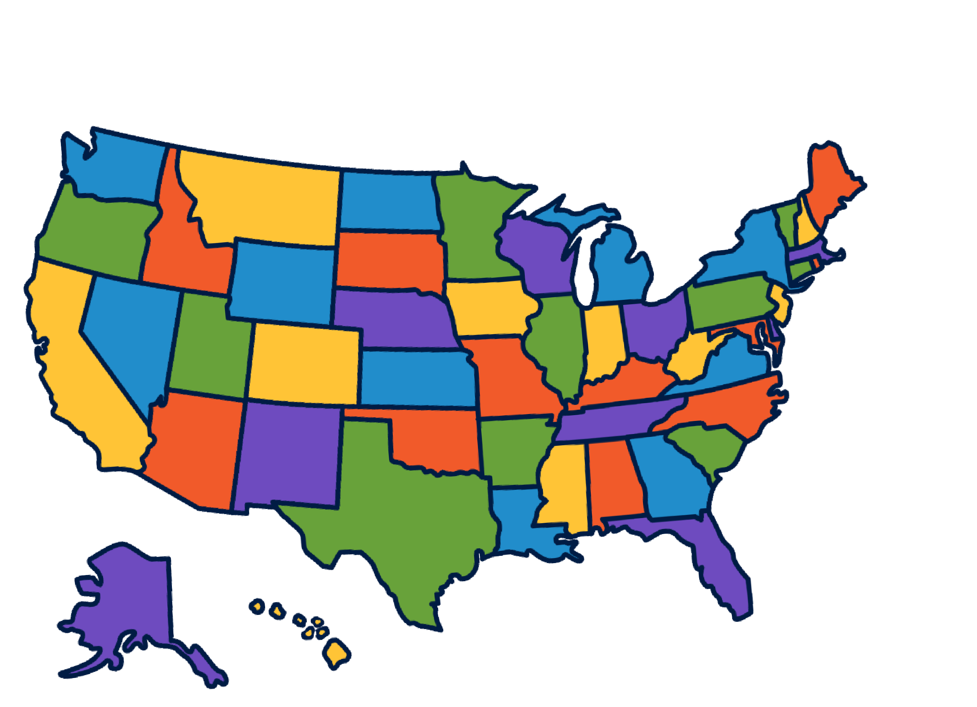

NASH represents public higher education systems across the U.S., which collectively enroll over 16 million students

Slide 3
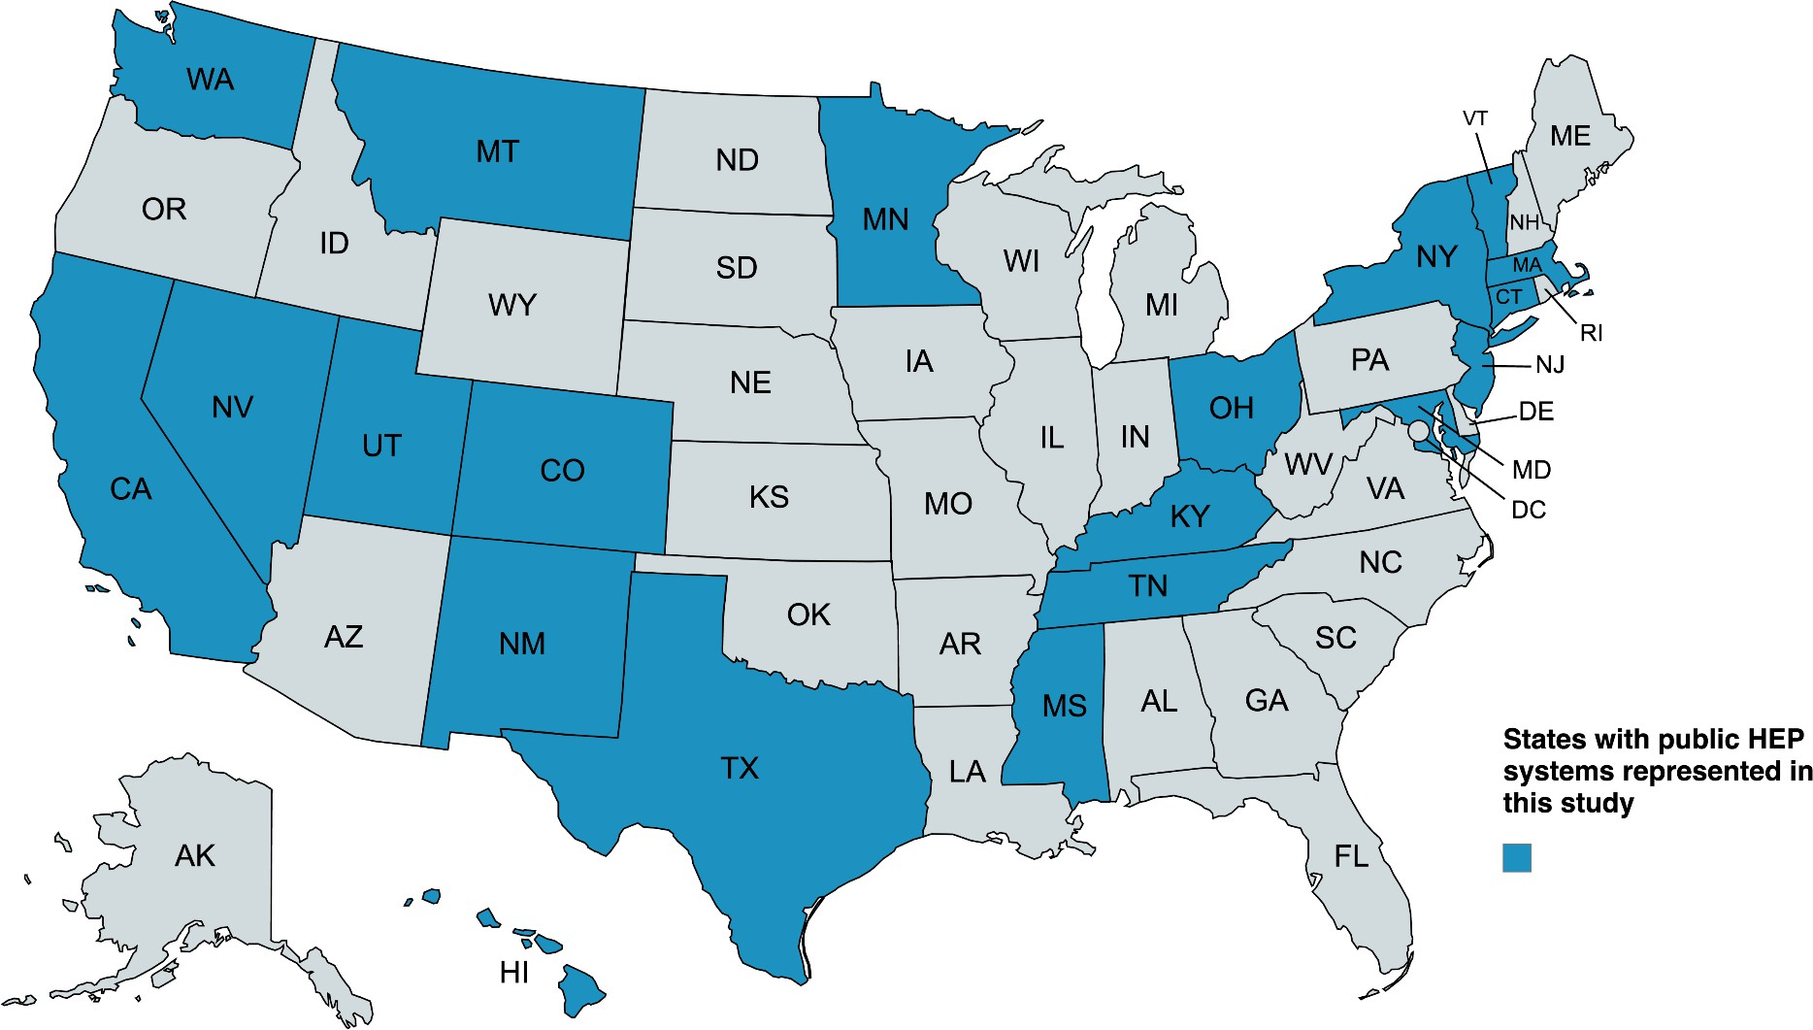
Map of States with Systems Included in Study
#PowerofSystems

Slide 4



System Attributes, Models, and Themes
#PowerofSystems

Slide 5
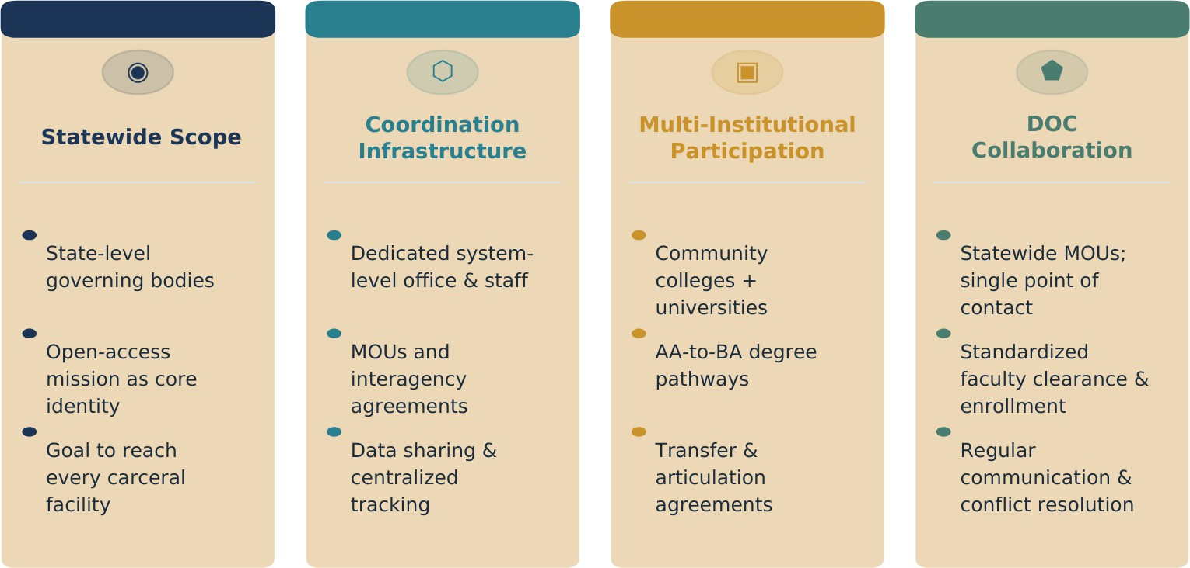
Common Public HEP System Attributes
#PowerofSystems

Slide 6






4 Operational Models Emerged

Slide 7

10. TECHNOLOGY & INFRASTRUCTURE
9. CURRICULUM & PROGRAM DESIGN
Access to technology remains a critical barrier despite increasing digital education needs.
Program offerings balance liberal arts, career technical education, and student demand.

Slide 8


8. REENTRY & POST-RELEASE SUPPORT
7. PROGRAM ACCESS & ENROLLMENT
Programs increasingly recognize reentry as integral to comprehensive and system-wide HEP offerings and services.
Reentry Infrastructure Distinguishes
Mature Systems
Expanding access while maintaining
quality presents ongoing tension.

Slide 9

6. DATA COLLECTION & ASSESSMENT
5. STAKEHOLDER ENGAGEMENT
Data infrastructure varies widely, affecting the ability to demonstrate outcomes.
Data Capacity Grows with the HEP Program.
Robust HEP programs actively engage in multiple stakeholder groups.
Workforce Development Integration Builds Political Currency & Political Champions Correlate with State Funding.

Slide 10

4. FACULTY & STAFF SUPPORT
3. DOC RELATIONSHIPS
Partnership quality with DOC directly impacts program access, operations, and student success.
Faculty recruitment, training, and retention present ongoing challenges for HEP programs.
HEP Systems with Formalized DOC
Partnerships are More Comprehensive

Slide 11

2. COORDINATION & GOVERNANCE
1. FUNDING & SUSTAINABILITY
Funding is transformative but fragile, and sustainability remains the field's biggest challenge.
Coordination structures vary from centralized offices to decentralized consortia.
State Funding Strongly Correlates with Scale and Sustainability

Slide 12
Campus Reentry Services
#PowerofSys tems

Slide 13

Campus Reentry Structure
HEP + Reentry
Resources
Staff & Students
Typically housed within HEP office & not a separate office
Staff report to HEP Directors
Not as robust as HEP programming
Most on campus & not system level
Dedicated campus staff have a student caseload
Focuses on HEP students
#PowerofSystems

Slide 14
Reentry Resources + Institution
Academic Advising
Career Preparation
Financial Aid & FASFA
Healthcare
Mental Health Services
Technology
Transcripts & Applications
Space

Slide 15
Reentry Resources + CBO Referral
Clothing
Employment
Essential documents
Food
Healthcare & Mental Health Services
Housing

Slide 16
Campus Reentry Resources
Alumni Support
Bridge/Reentry Course
Cost of Living Stipend
Digital Literacy
Meeting with Staff
Reentry Plan
Social Supports
Staff Training
Tuition & Scholarships

Slide 17
Insights from Administrators
Funding emerged as the most discussed theme, with all interviewees addressing financial challenges and sustainability
Reentry coordination between DOC, Systems, individual campuses, and community based organizations (CBO) varied widely
Faculty support was key to students sense of belonging
There is a heavy reliance on CBO referrals to fill gaps
Data Collection and Assessments need to be established and/or centralized
Reentry services cater to HEP students
Digital literacy is a hinderance to many justice-impacted students
#PowerofSystems

Slide 18
Campus Reentry Experience: The Student Perspective
#PowerofSystems

Slide 19
Transitioning to Campus
Incarceration
HEP Student
Justice Impacted Person
Reentry Services Within Facility
Facility Reentry Services
HEP Reentry Services
No Reentry Services Inside Facility
Transition to Campus
Campus Reentry Services
No Campus Reentry Services

Slide 20
Voices of Justice-Impacted Students (1)
Funding emerged as the most discussed theme, with all interviewees addressing financial challenges of attending school and meeting their basic needs
DOC requirements hinder enrollment or make it more challenging
Faculty support was key to students sense of belonging and matriculation
“Behind the wall I taken up some classes with culinary art. I didn't think they (the institution) would have that information because that was actually confidential behind the wall. So I signed up for [the class], and then they said they needed my transcripts. I didn't know nothing about transcripts. I didn't even know how to get this. So I started calling the schools that I went to, and I remember them telling me that it was going to cost me $6. And that grandson gave me $6 that year to get my transcripts.”

Slide 21
Voices of Justice-Impacted Students (2)
Access to reentry services varied based on the student's needs and if they knew of resources.
There is a need for services to meet their basic needs
Digital literacy is a hinderance to many justice-impacted students coming home into a digital world
“It was balancing coming back into society and having enough time to delegate to classes, as well as having enough time to delegate for your basic needs, food, rent and transportation. [This city] is not the cheapest place to live, so it's kind of hard to find good work and good means of transportation and food and funds. So that was the biggest challenge that I'm still currently kind of dealing with. Because it's not easy to go to school.”

Slide 22
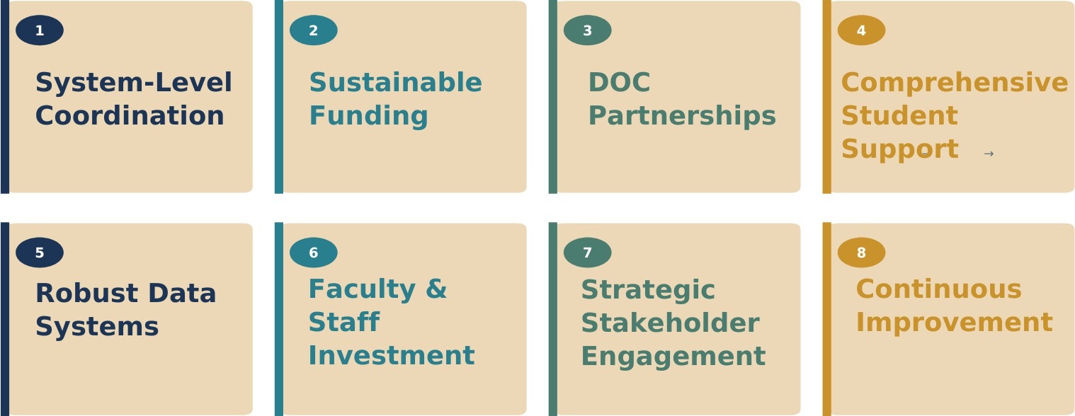
8 Recommendations for Building Sustainable, Systems-Level HEP Programs
#PowerofSystems

Slide 23



Conclusion
HEP and reentry must be embedded within the system — not siloed — and must support students across their entire educational journey: inside, through release, and through degree completion.
#PowerofSystems

Slide 24

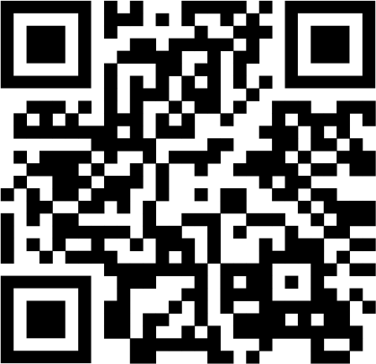
THANK YOU
ACCESS THE REPORT
LEARN MORE AT NASH.EDU
#PowerofSystems

